Slide 1

Security Does Not Need To Be Fun: Ignoring OWASP To Have A Terrible Time

Slide 2
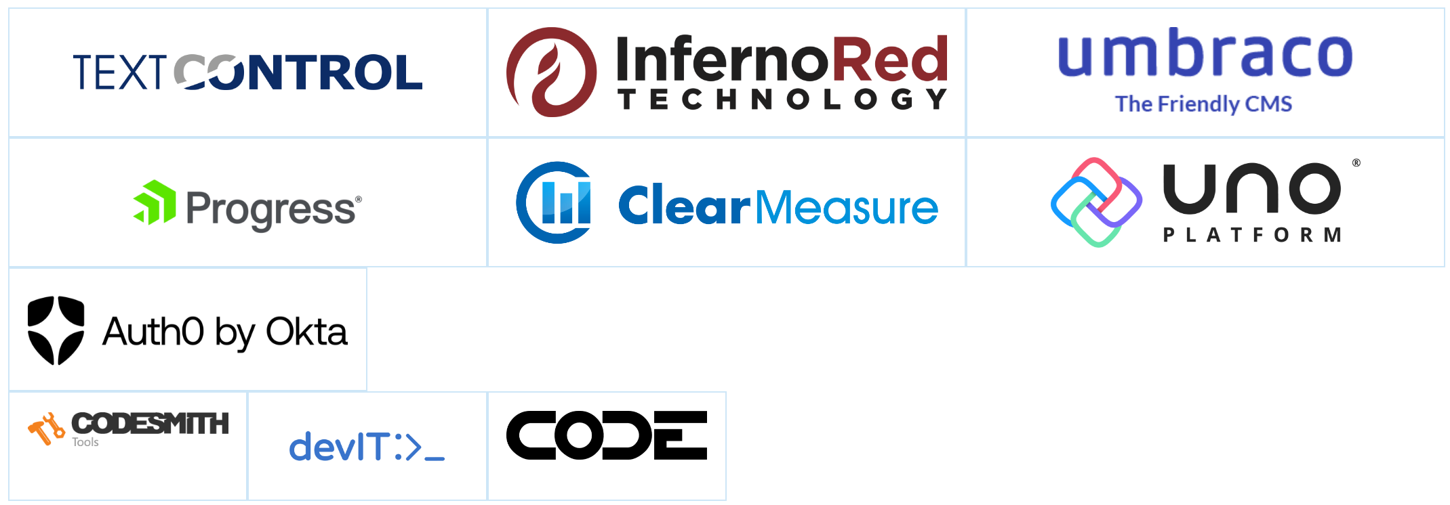
Thank you TechBash 2023 Sponsors!

Slide 3

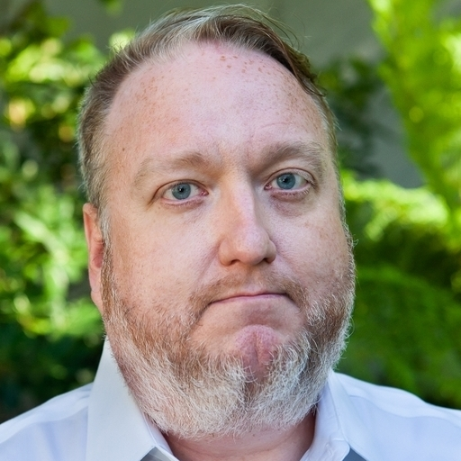

Hi, I’m Dwayne
I live in Chicago
I’ve been a Developer Advocate since 2016
Socials: @mcdwayne
@mcdwayne@mastodon.social
Happy to chat about anything, hit me up
Outside of tech, I love improv, karaoke and rock and roll
Dwayne McDaniel

Slide 4

About GitGuardian
GitGuardian is the code security platform for the DevOps generation.
—
We help enterprises answer the issue of "Where are my hardcoded secrets?"

Slide 5


Slide 6
What Does Good Security Look Like?

Slide 7

Notes:
https://unsplash.com/photos/MtBsjmC4RT0

Slide 8
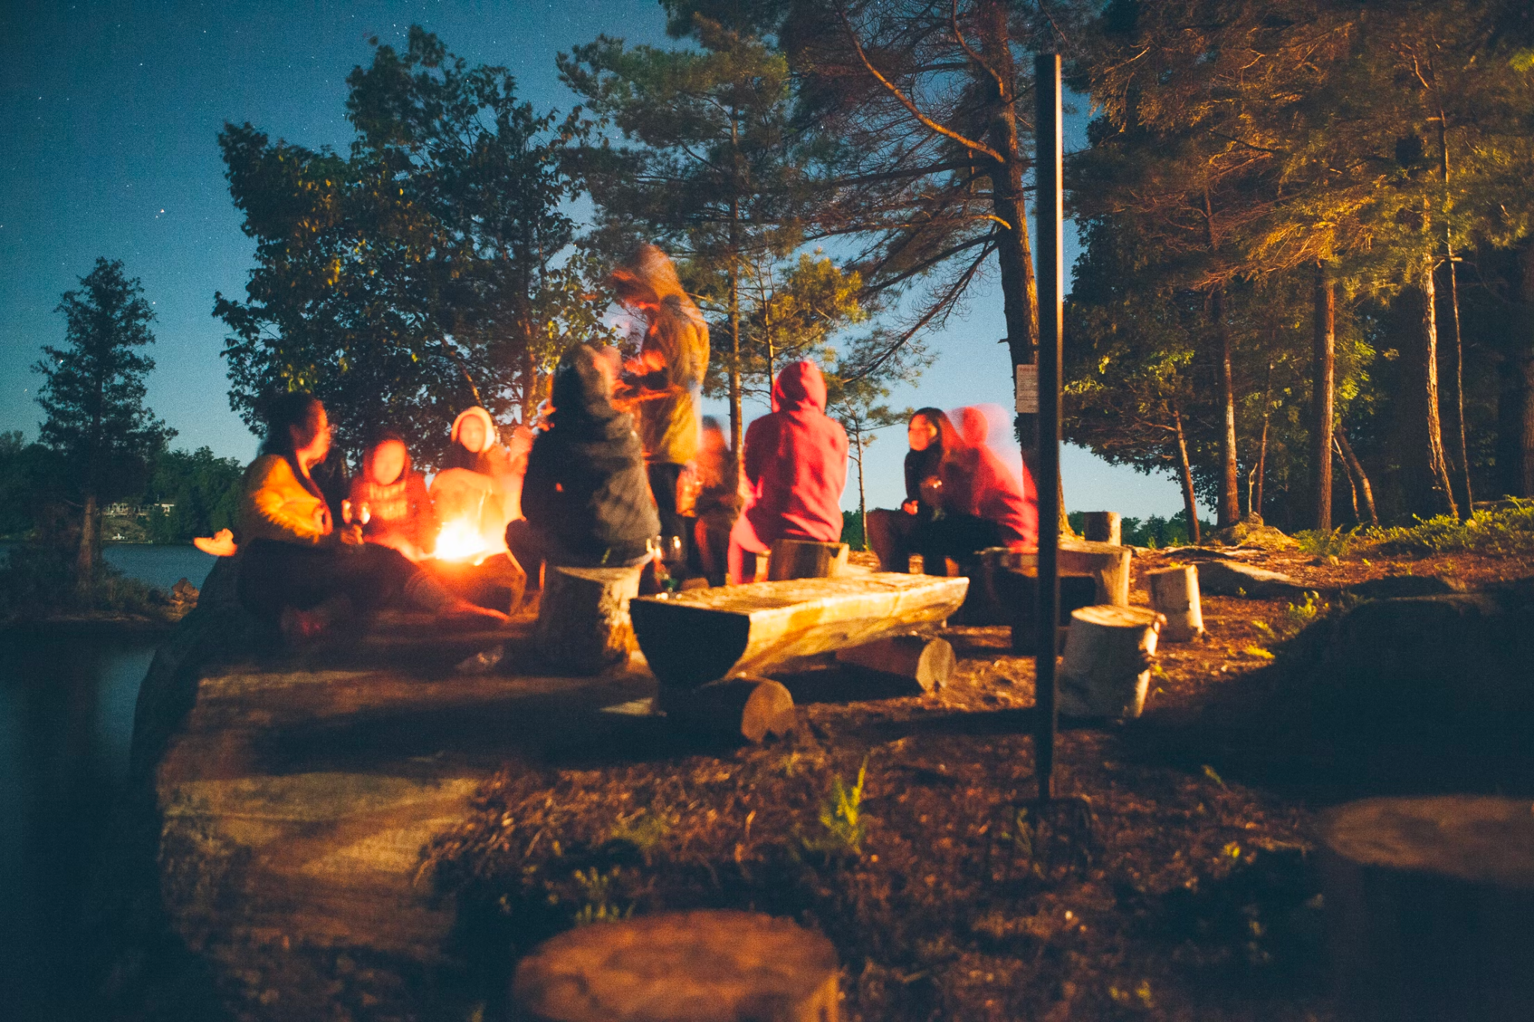
Notes:
https://unsplash.com/photos/fDostElVhN8

Slide 9

Notes:
https://unsplash.com/photos/ZhQCZjr9fHo

Slide 10
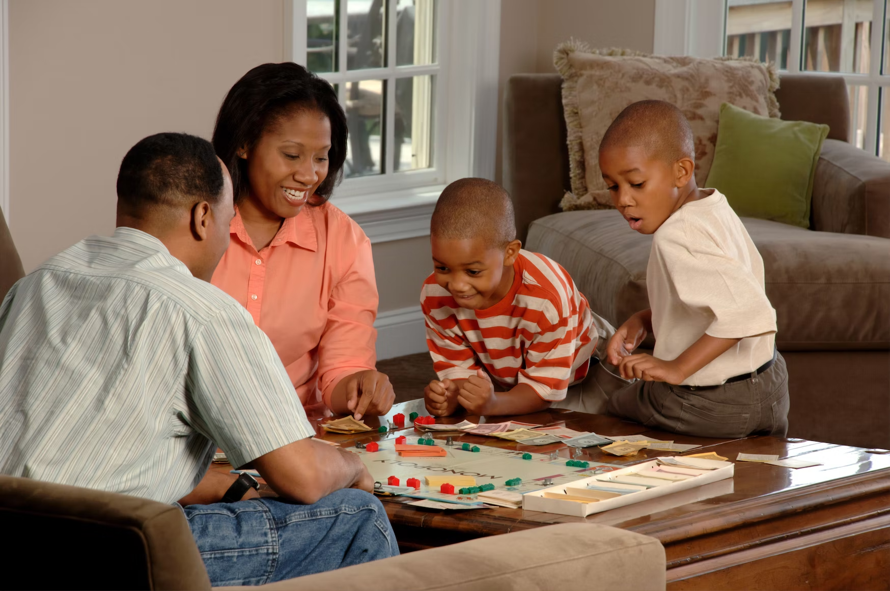
Notes:
https://unsplash.com/photos/VJVsEnR_vNE

Slide 11
All Technology Has Human Costs
Notes:
Dev
DevOps
QA
Security

Slide 12
What Does Bad Security Look Like?
Notes:
Dev
DevOps
QA
Security

Slide 13

Notes:
https://unsplash.com/photos/pClBZjxdxn8

Slide 14
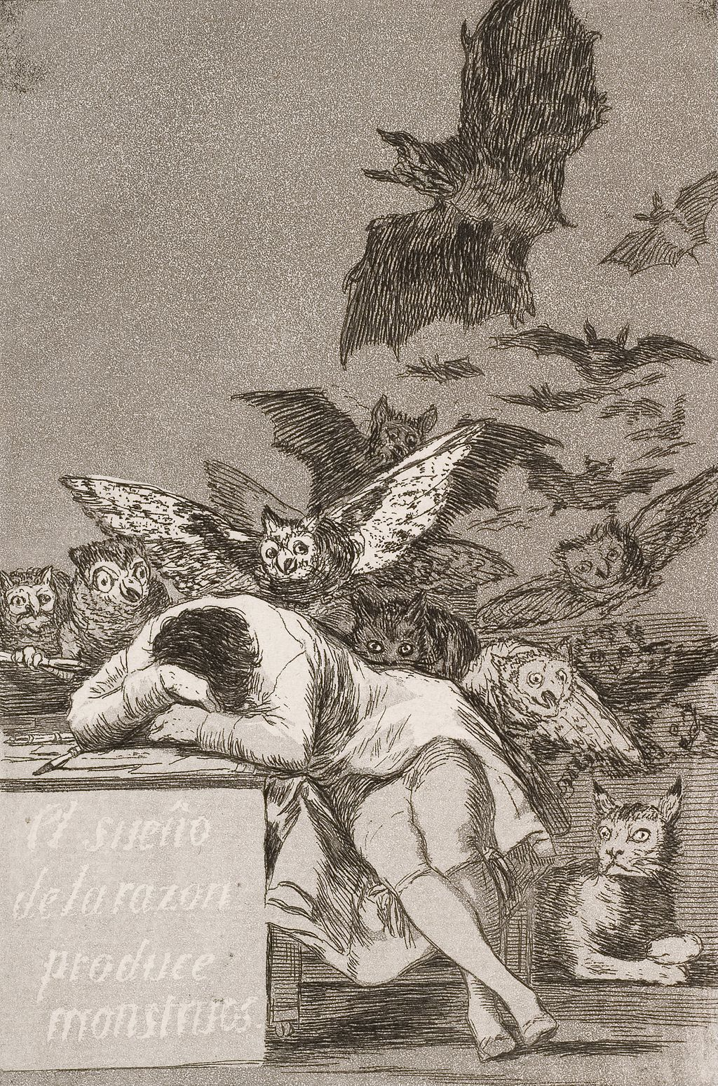
Notes:
https://unsplash.com/photos/pClBZjxdxn8

Slide 15

Notes:
https://unsplash.com/photos/S2AcayPkszE

Slide 16
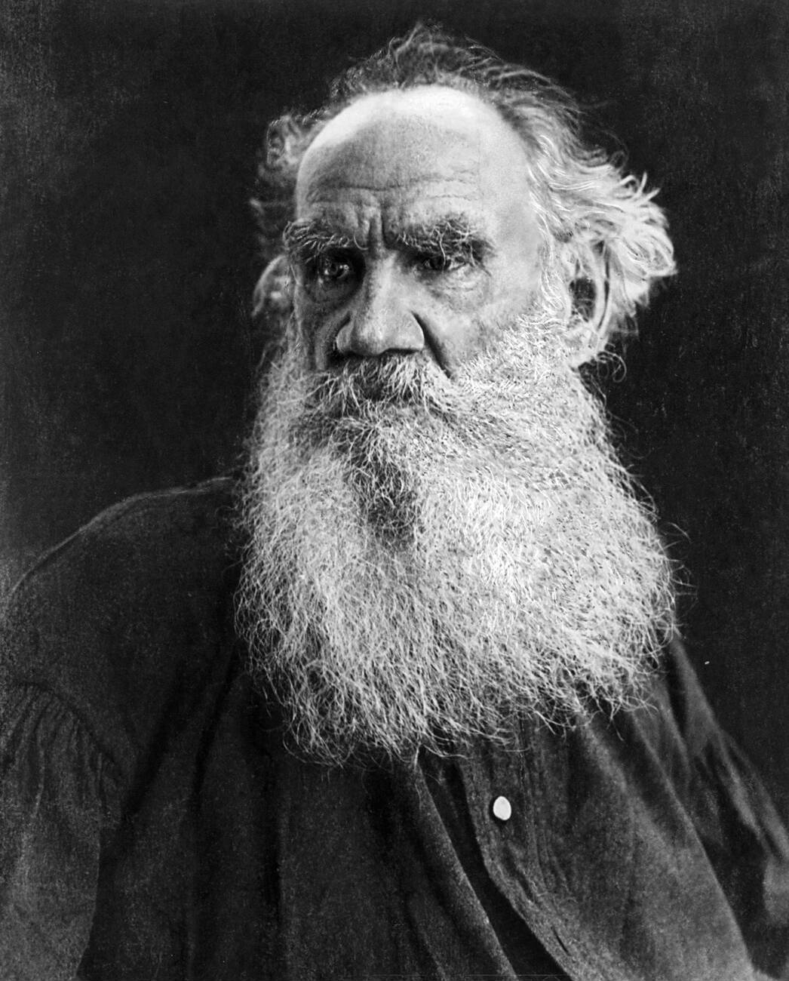
“All happy families are alike; each unhappy family is unhappy in its own way.”
― Leo Tolstoy , Anna Karenina
Notes:
https://en.wikipedia.org/wiki/Leo_Tolstoy#/media/File:Tolstoy_Leo_port.jpg Public domain

Slide 17

Uber Breach – September 2022
A Few Unhappy Families Companies
Credential access
2FA/MFA spamming
Uber Internal Network
One exposed secret leads to many others!
Some mistakes are more expensive than others. One hardcoded secret giving access to Uber’s PAM solution led to a an organization wide IT takeover…
Initial access
Scanning
Uber’s Infra
VPN Access
Discovery
PowerShell script contained hardcoded credentials
PowerShell scripts in network share
Privilege escalation
Access to internal apps
AWS, GCP, Google Drive, Slack, SentinelOne, HackerOne admin console, Internal employee dashboards…
Admin access to
Thycotic PAM
Lateral movement

Slide 18

CircleCI – January 2023
A Few Unhappy Families Companies
Use of a honeytoken alerted the security team of the breach
Remote Engineer
Attacker
Development System
Customer secrets stolen, unauthorised access to GitHub repos and third-party systems
Embedded Malware Used To Steal Secrets
GitHub
CircleCI Platform
CircleCI Internal Network
Hardcoded AWS, GCP, Google Drive, Internal employee dashboards, unencrypted customer data …
Hardcoded AWS, GCP, Google Drive, Internal employee dashboards, unencrypted customer data …
Hardcoded AWS, GCP, Google Drive, Internal employee dashboards, unencrypted customer data …
Customer Application
Customer Application
Customer Application

Slide 19

AstraZeneca – November 2022
A Few Unhappy Families Companies
Unknown number of affected end users
Developer 2
Developer 1
Test environment credentials pushed to GitHub. Another user pushed real patient data to the test environment.
Credentials were exposed for over a year before reported. Number of patients affected was never disclosed.
Test Env Credentials
Patient Data
Publicly Accessible
Public
GitHub
Repo
Test Env

Slide 20
A Few Unhappy Families Companies
Apache Log4Shell CVE-2021-44228
Thousands of product companies affected:
Adobe, Cisco, AWS, Broadcom, IBM, Okta, VMware
Potential impact to any of their thousands of customers

Slide 21
Security Teams Are Outnumbered
Notes:
100 to 1

Slide 22
In the best organizations developers outnumber security team members 100:1 - Alex Rice, HackerOne #Security@2022 🕺🕺🕺🕺🕺🕺🕺🕺🕺🕺🕺🕺🕺🕺🕺🕺🕺🕺🕺🕺
🕺🕺🕺🕺🕺🕺🕺🕺🕺🕺🕺🕺🕺🕺🕺🕺🕺🕺🕺🕺
🕺🕺🕺🕺🕺🕺🕺🕺🕺🕺🕺🕺🕺🕺🕺🕺🕺🕺🕺🕺🚨
🕺🕺🕺🕺🕺🕺🕺🕺🕺🕺🕺🕺🕺🕺🕺🕺🕺🕺🕺🕺
🕺🕺🕺🕺🕺🕺🕺🕺🕺🕺🕺🕺🕺🕺🕺🕺🕺🕺🕺🕺

Slide 23
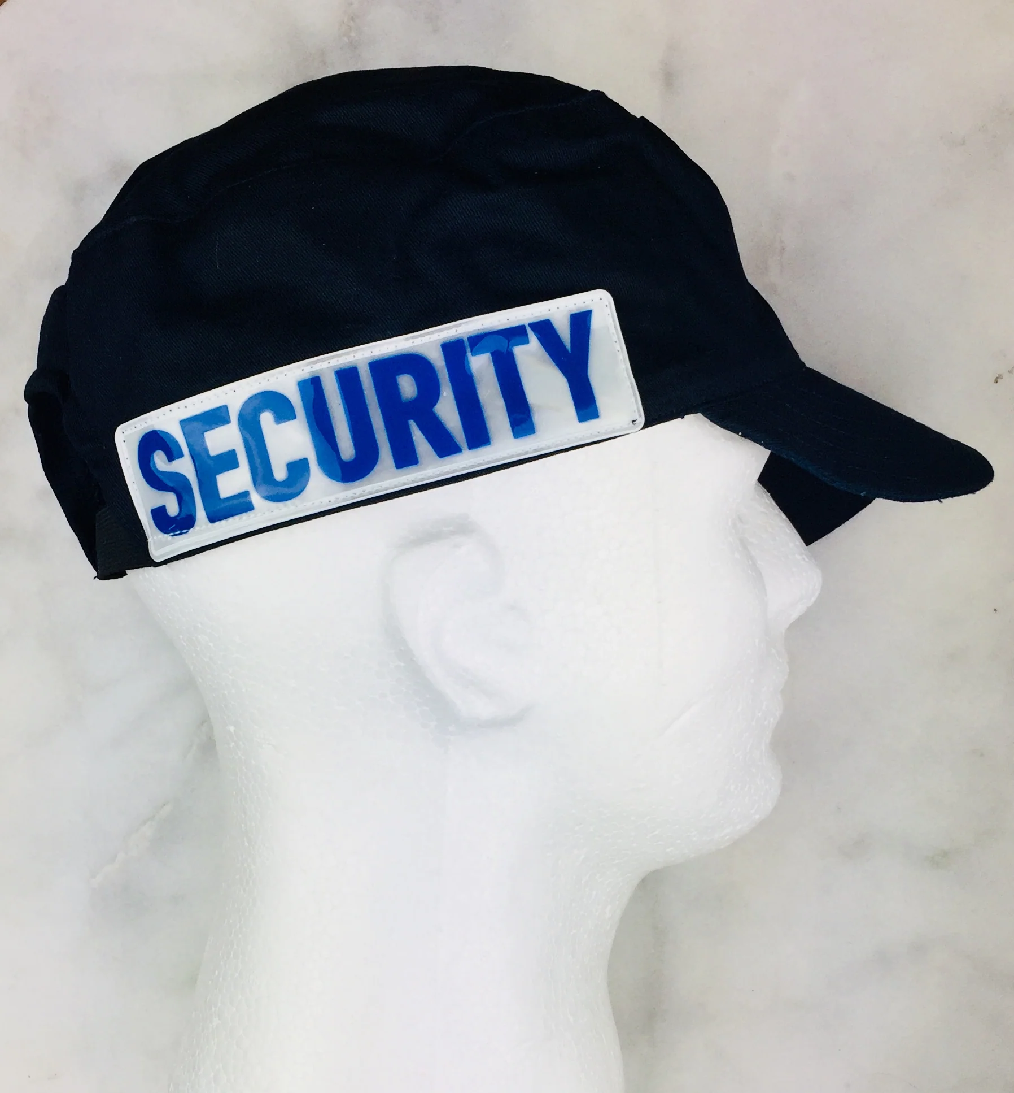
DEVELOPER
Notes:
Art from https://www.pdclipart.org/thumbnails.php Public domain

Slide 24
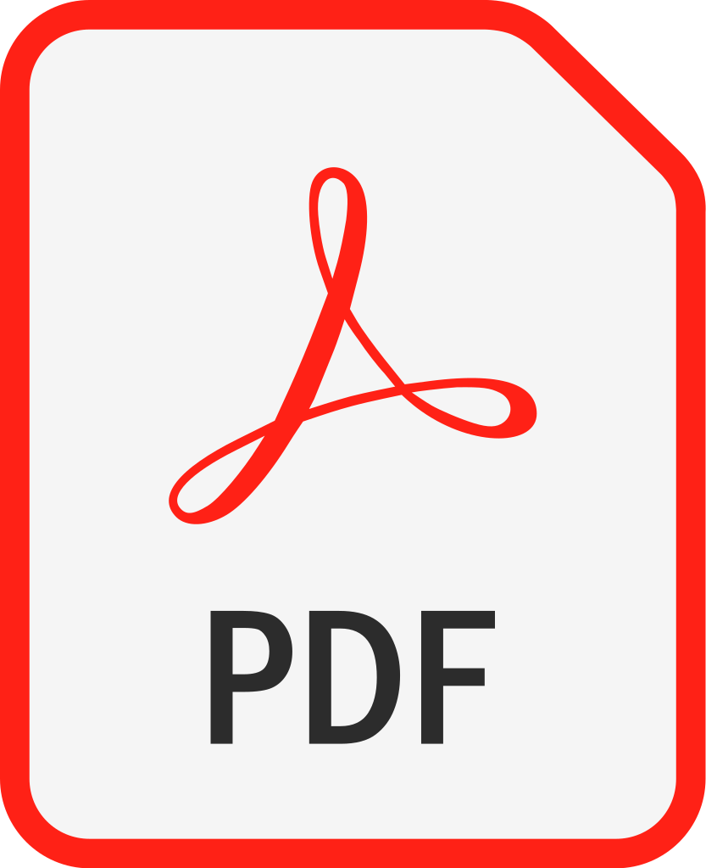

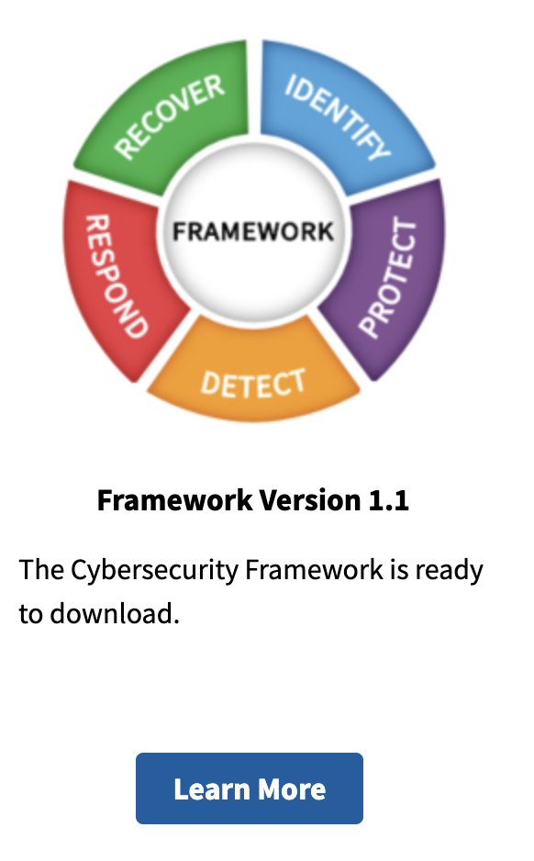
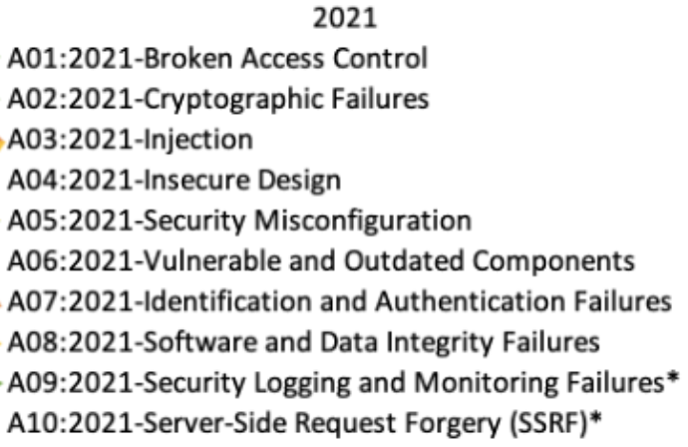
Notes:
Art from https://www.pdclipart.org/thumbnails.php Public domain

Slide 25
Notes:
Art from https://www.pdclipart.org/thumbnails.php Public domain

Slide 26
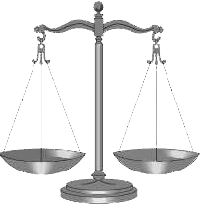


But Devs Already Have A Lot To Worry About:
Delivery deadlines
Billable hours
Number of tickets closed
Bugs
DevOps
Fighting Kubernetes
Only so much time
Notes:
Art from https://www.pdclipart.org/thumbnails.php Public domain

Slide 27
Business Priority View of Security
Security Incident
Security Incident
Focus On Security
Focus On New Feature Delivery Times
Delivery Slows Down
Notes:
Art from https://www.pdclipart.org/thumbnails.php Public domain

Slide 28
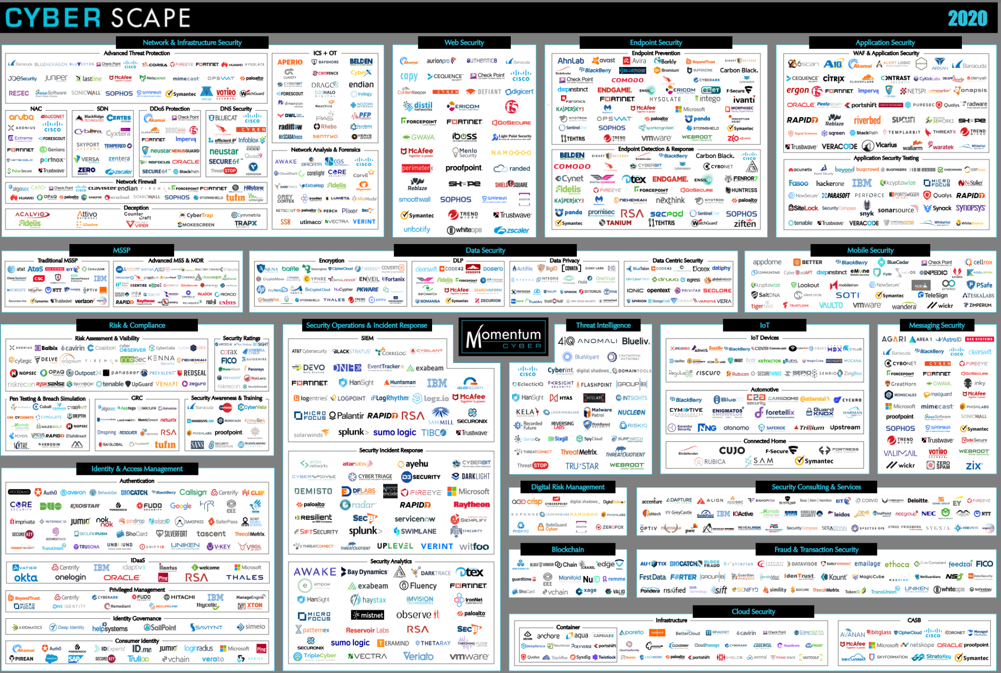
The Number Of Security Tools Is Overwhelming
Notes:
https://www.guidepointsecurity.com/wp-content/uploads/2019/08/CYBERscape.pdf https://www.guidepointsecurity.com/blog/6-best-practices-evaluating-cybersecurity-tools/

Slide 29
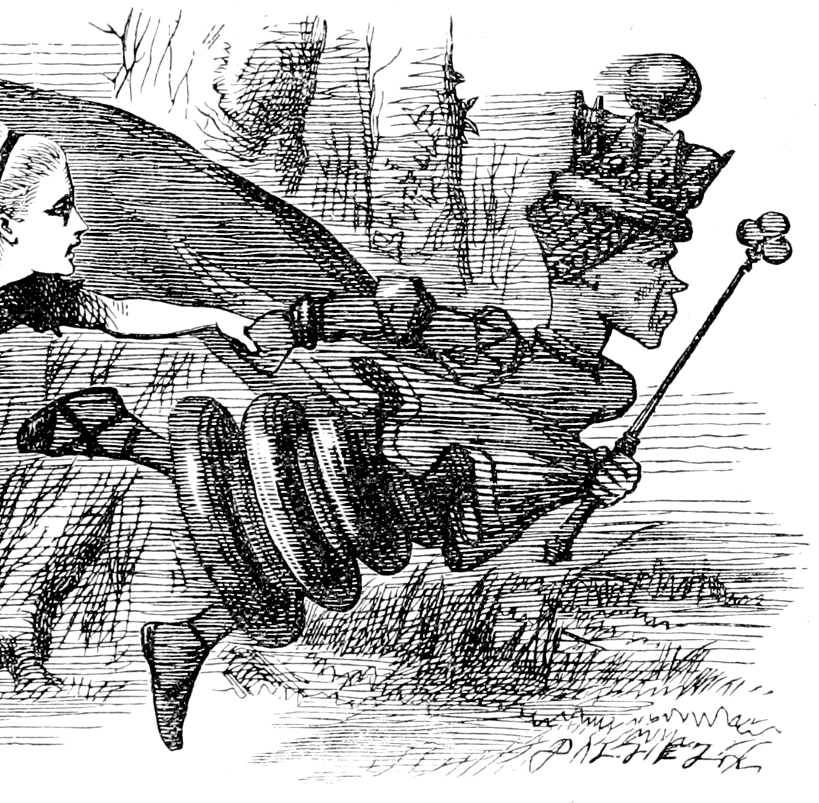
Now, here, you see, it takes all the running you can do, to keep in the same place. If you want to get somewhere else, you must run at least twice as fast as that!
― The Red Queen, Through the Looking-Glass, and What Alice Found There
Notes:
https://en.wikipedia.org/wiki/Red_Queen%27s_race Public domain

Slide 30





We Need To Act As One Team
Notes:
https://en.wikipedia.org/wiki/The_A-Team_(season_4)

Slide 31
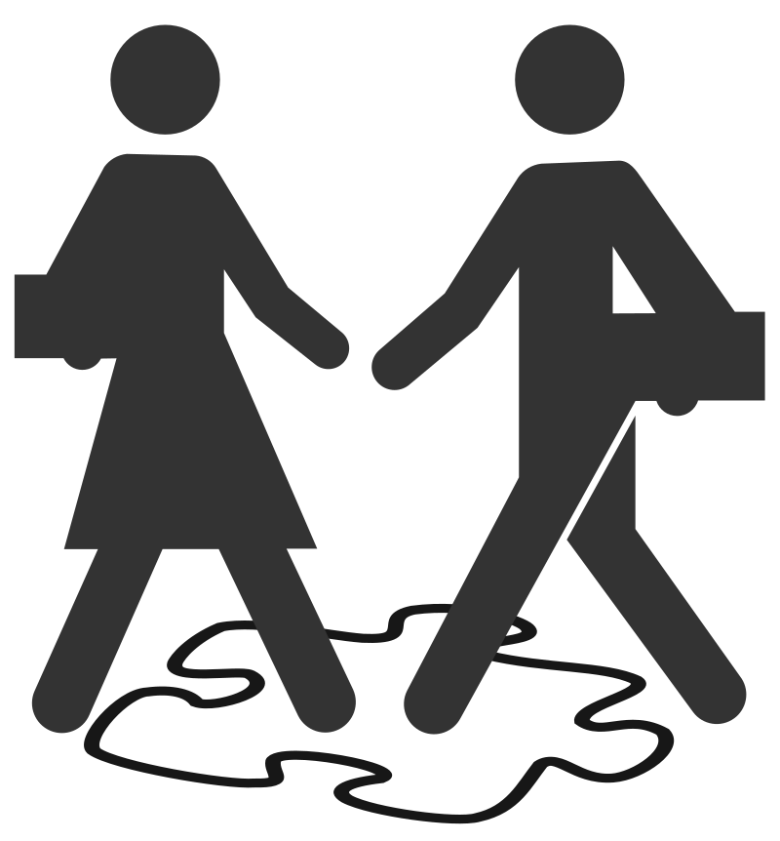
SECURITY
DEVOPS

Slide 32
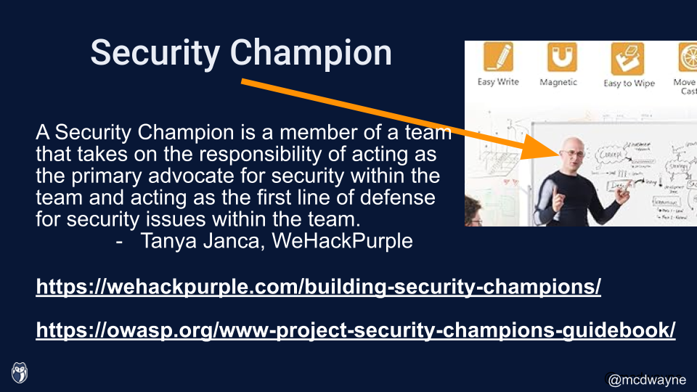
SECURITY
DEVOPS

Slide 33

I Wish Some Benevolent
Group Of Security Experts Could Help Me With This Stuff

Slide 34

Open Web Application Security Project

Slide 35
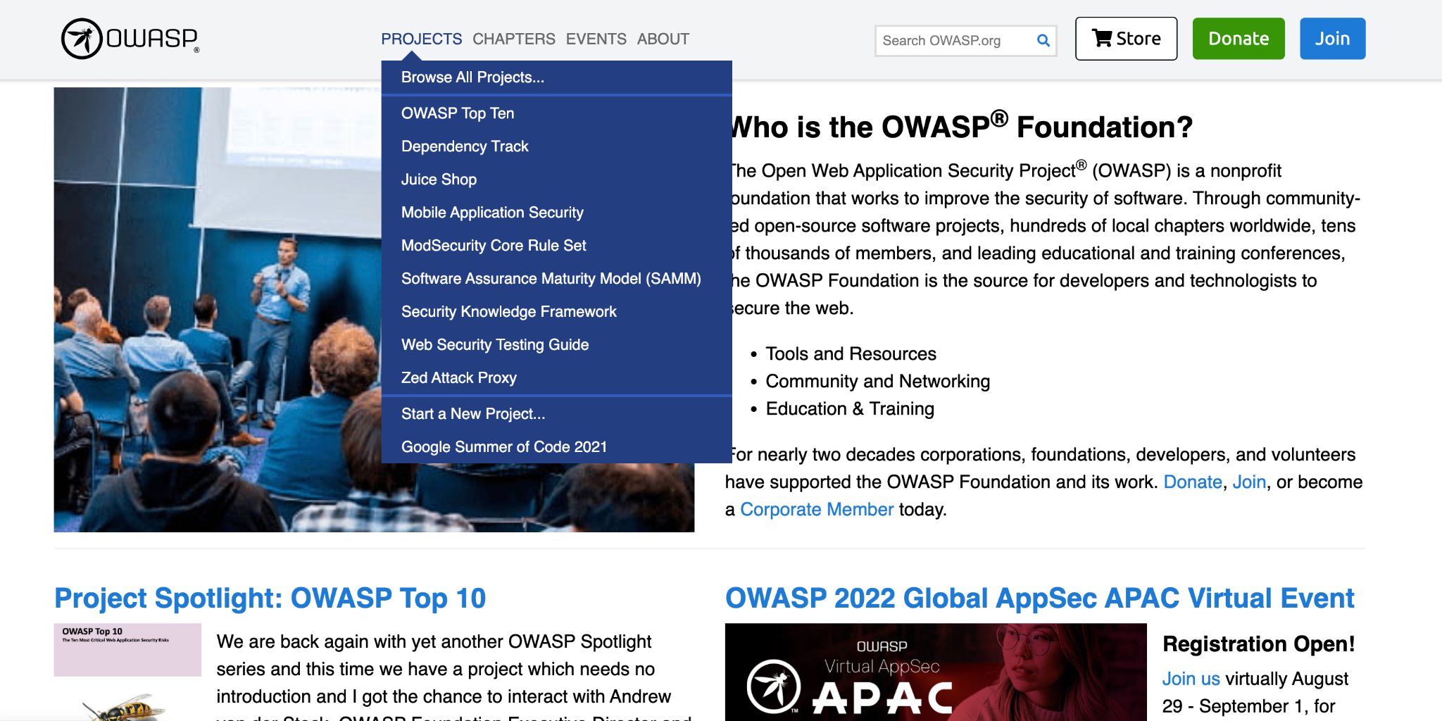
OWASP.ORG

Slide 36
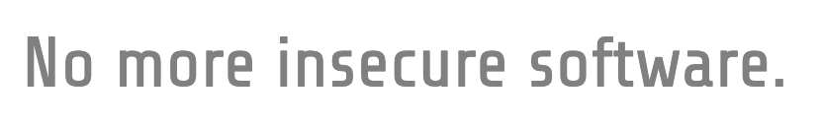
OWASP Mission

Slide 37
OWASP Mission
As the world’s largest non-profit organization concerned with software security, OWASP:
Supports the building of impactful projects;
Develops & nurtures communities through events and chapter meetings worldwide; and
Provides educational publications & resources
in order to enable developers to write better software, and security professionals to make the world’s software more secure.

Slide 38
Projects
Communities
Events
Education and Training
Publications and Resources
OWASP Overview

Slide 39
Community

Slide 40
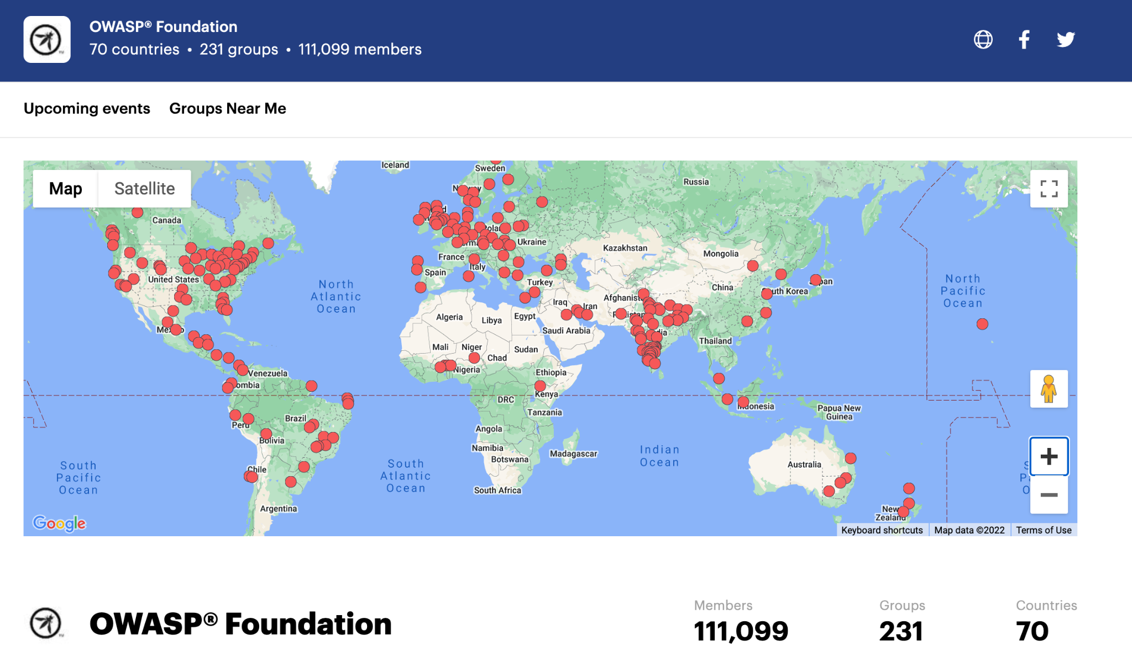
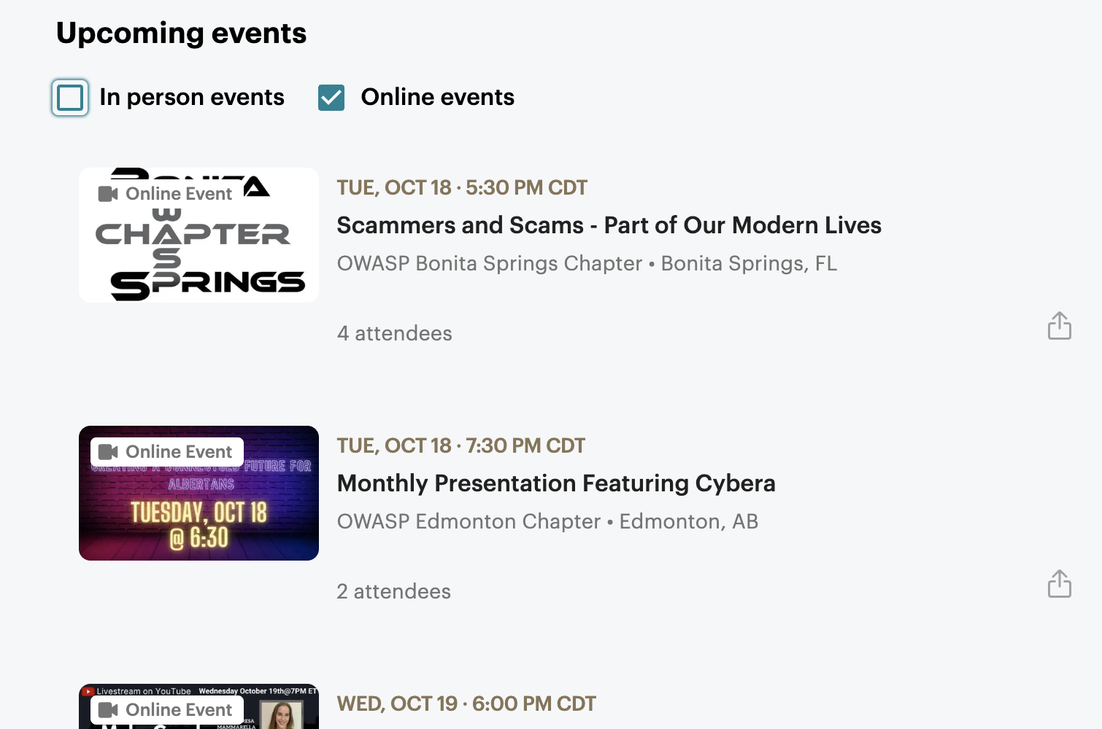
OWASP Community
Chapters all over the world
Organized via MeetUp in most areas Many online events

Slide 41
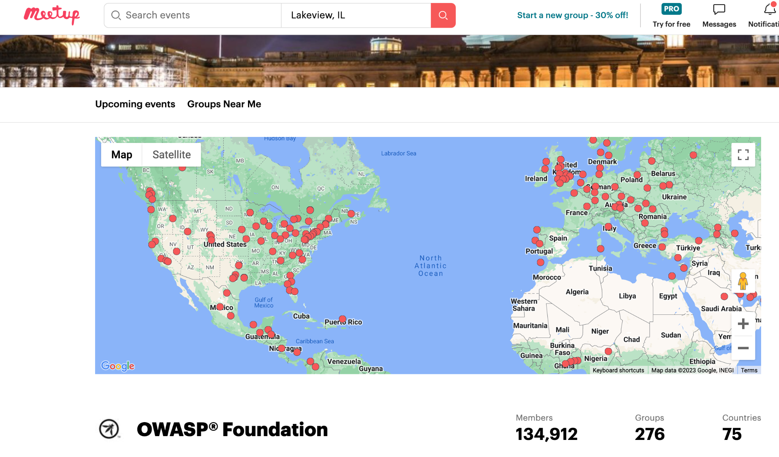
https://www.meetup.com/pro/owasp/

Slide 42
Projects

Slide 43
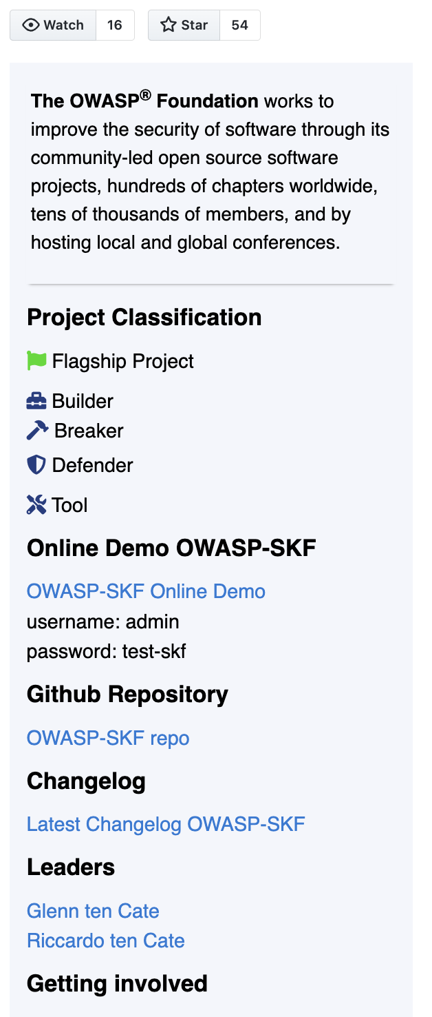
OWASP Projects
The core organizing concept for OWASP
Open Source repos
Built by volunteers and experts
New weekly submissions from the community
~303 total projects in any state
~187 in "usable" state

Slide 44
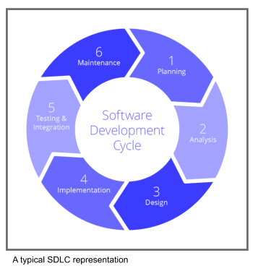

Notes:
https://unsplash.com/photos/MtBsjmC4RT0

Slide 45
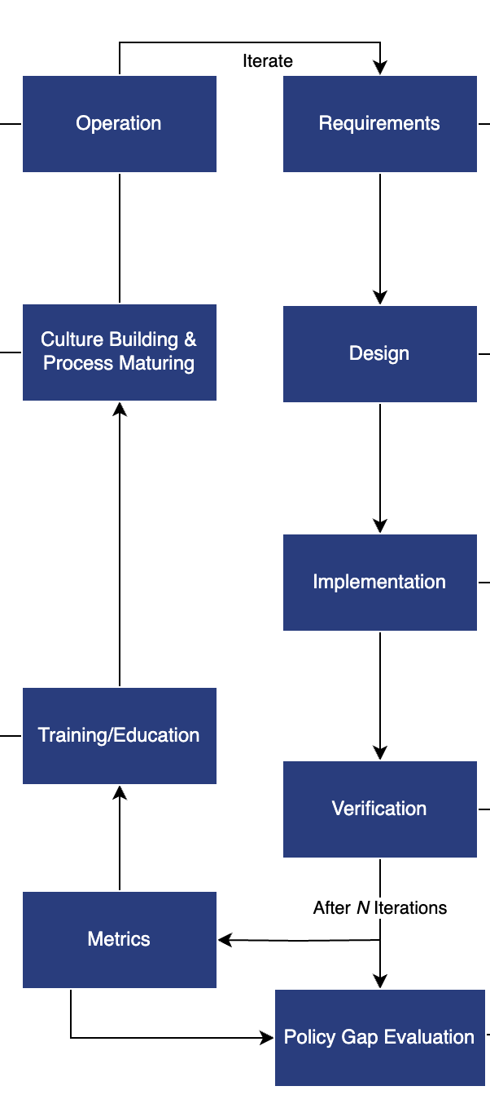
The “Full” SDLC:
Requirements
Design
Implementation
Verification
Policy Gap Evaluation
Metrics
Training/Education
Culture building and process maturing
Operation
Notes:
https://unsplash.com/photos/MtBsjmC4RT0

Slide 46
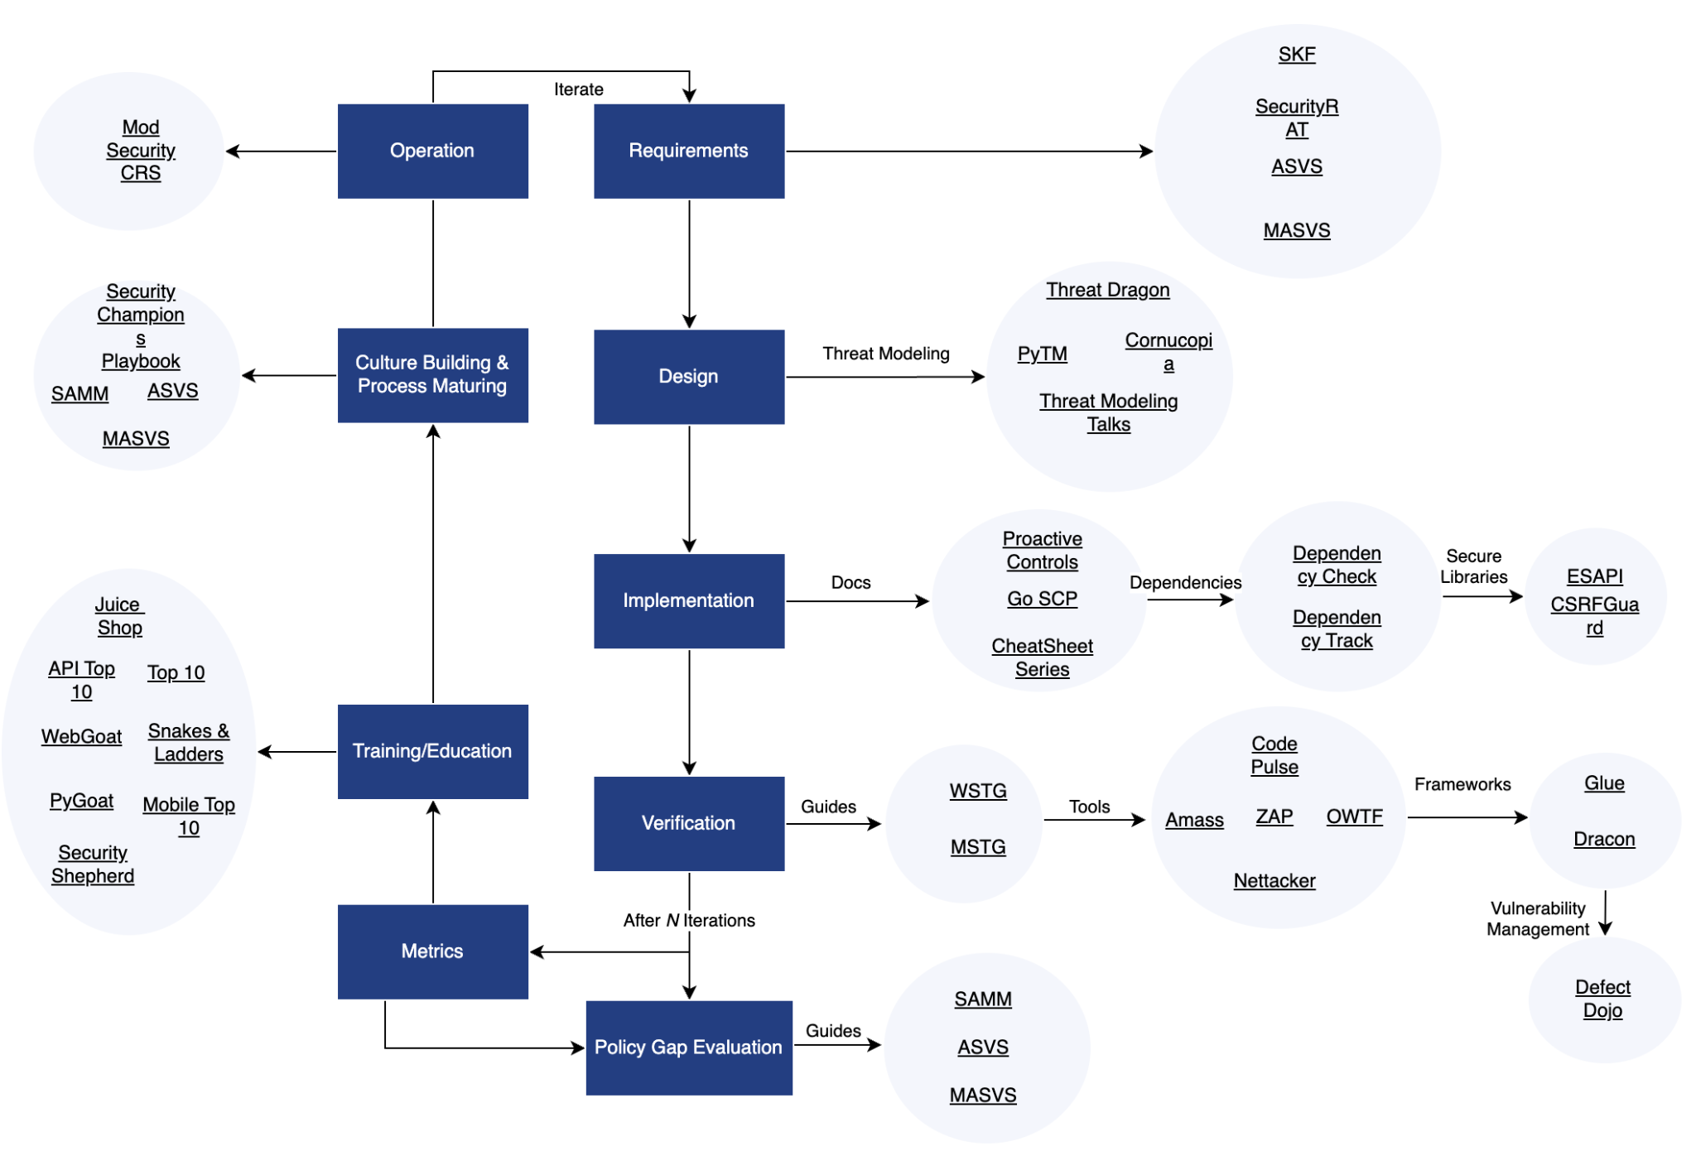
OWASP Security Wayfinder
Organized around CRE, Common Requirement Enumeration

Slide 47
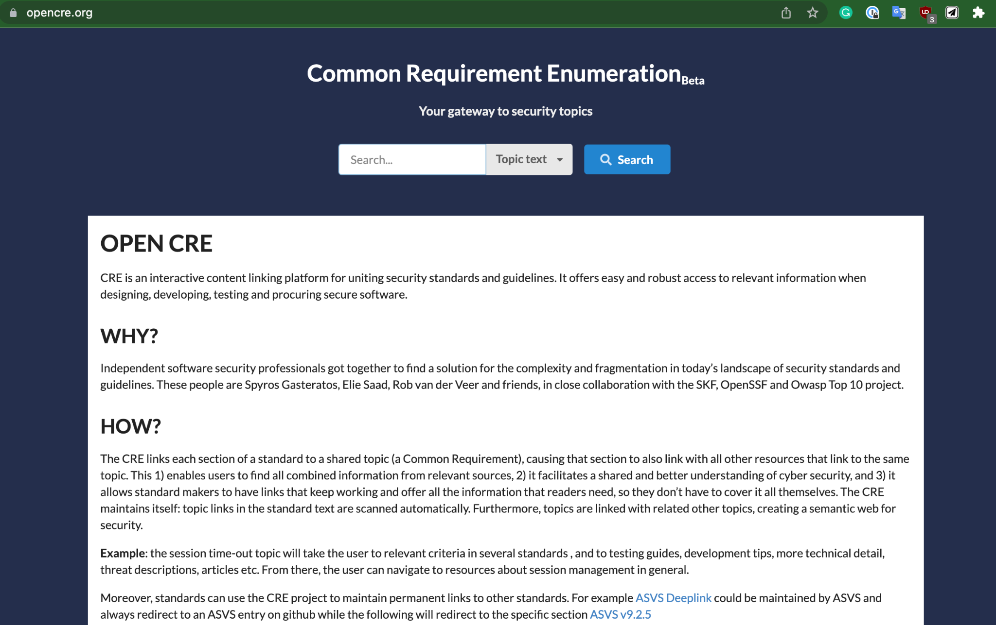
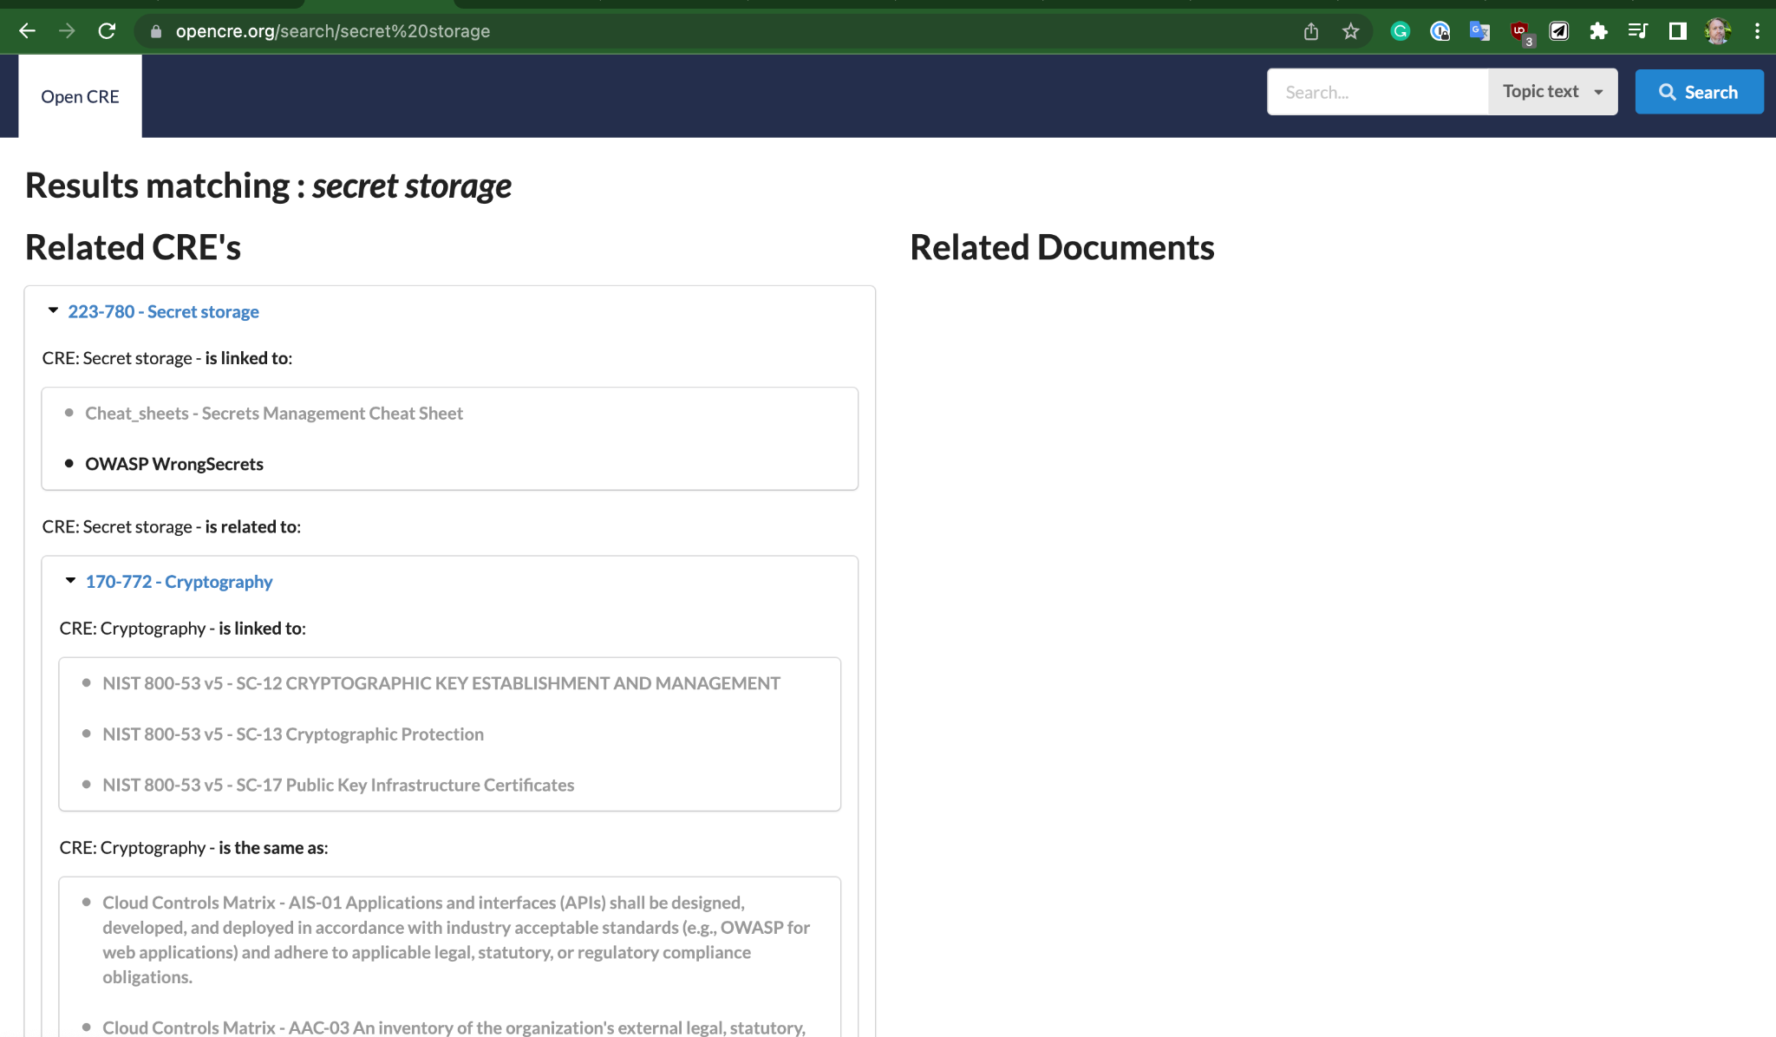
OWASP CRE
Links together standards (NIST, CWE) in a coherent way
Helps clarify what each OWASP project is specifically addressing
https://www.opencre.org allows you to just search the high level topic
Notes:
https://www.youtube.com/watch?v=7knF14t0Svg

Slide 48
The “Full” SDLC:
Requirements
Design
Implementation
Verification
Policy Gap Evaluation
Metrics
Training/Education
Culture building and process maturing
Operation
Notes:
https://unsplash.com/photos/MtBsjmC4RT0

Slide 49
Requirements

Slide 50
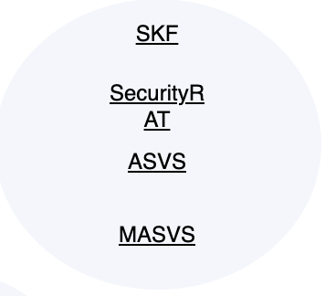
Requirements Related Projects
Security Knowledge Framework (Training platform)
Security RAT (Requirement Automation Tool)
Application Security Verification Standard^
Mobile Application Security Verification Standard^ ^=(1st appearance)
Notes:
https://www.youtube.com/watch?v=7knF14t0Svg

Slide 51
Design

Slide 52
Design concerns the processes and activities related to how an organization defines goals and creates software within development projects.
In general, this will include requirements gathering, high-level architecture specification and detailed design.

Slide 53
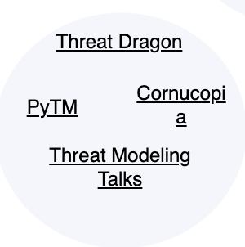
Design Related Projects
Threat Dragon (modeling tool)
PyTM (modeling tool in Python)
Cornucopia (card game)
Threat Modeling Toolkit Talk (YouTube link)
Notes:
https://www.youtube.com/watch?v=7knF14t0Svg

Slide 54
Implementation

Slide 55
Implementation is focused on the processes and activities related to how an organization builds and deploys software components and its related defects.
Activities within the Implementation function have the most impact on the daily life of developers. The joint goal is to ship reliably working software with minimum defects.

Slide 56
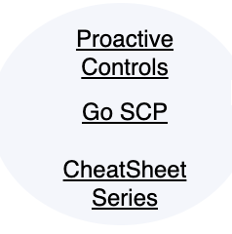
Implementation Related Projects - Docs
Proactive Controls (A Top 10 list)
Go Secure Coding Practices Guide (a free ebook)
Cheat Sheets*
Notes:
https://www.youtube.com/watch?v=7knF14t0Svg

Slide 57
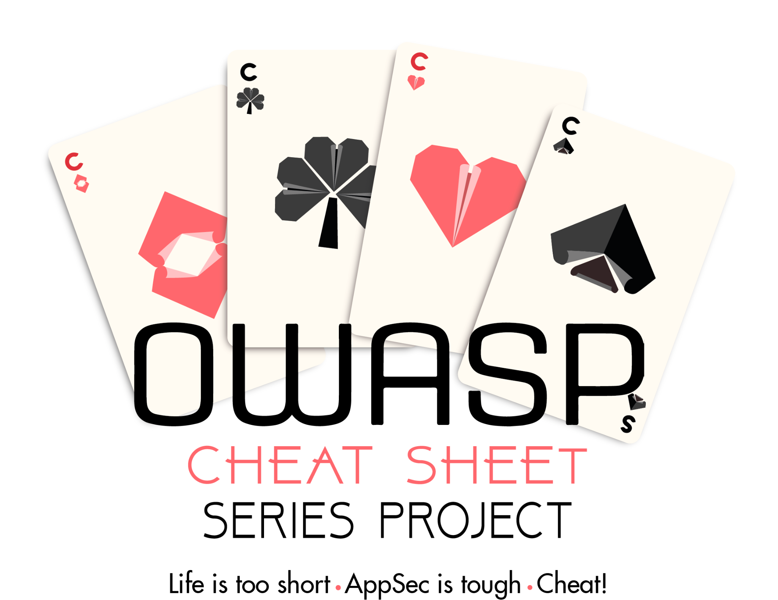
OWASP Cheat Sheet Series
https://cheatsheetseries.owasp.org/

Slide 58
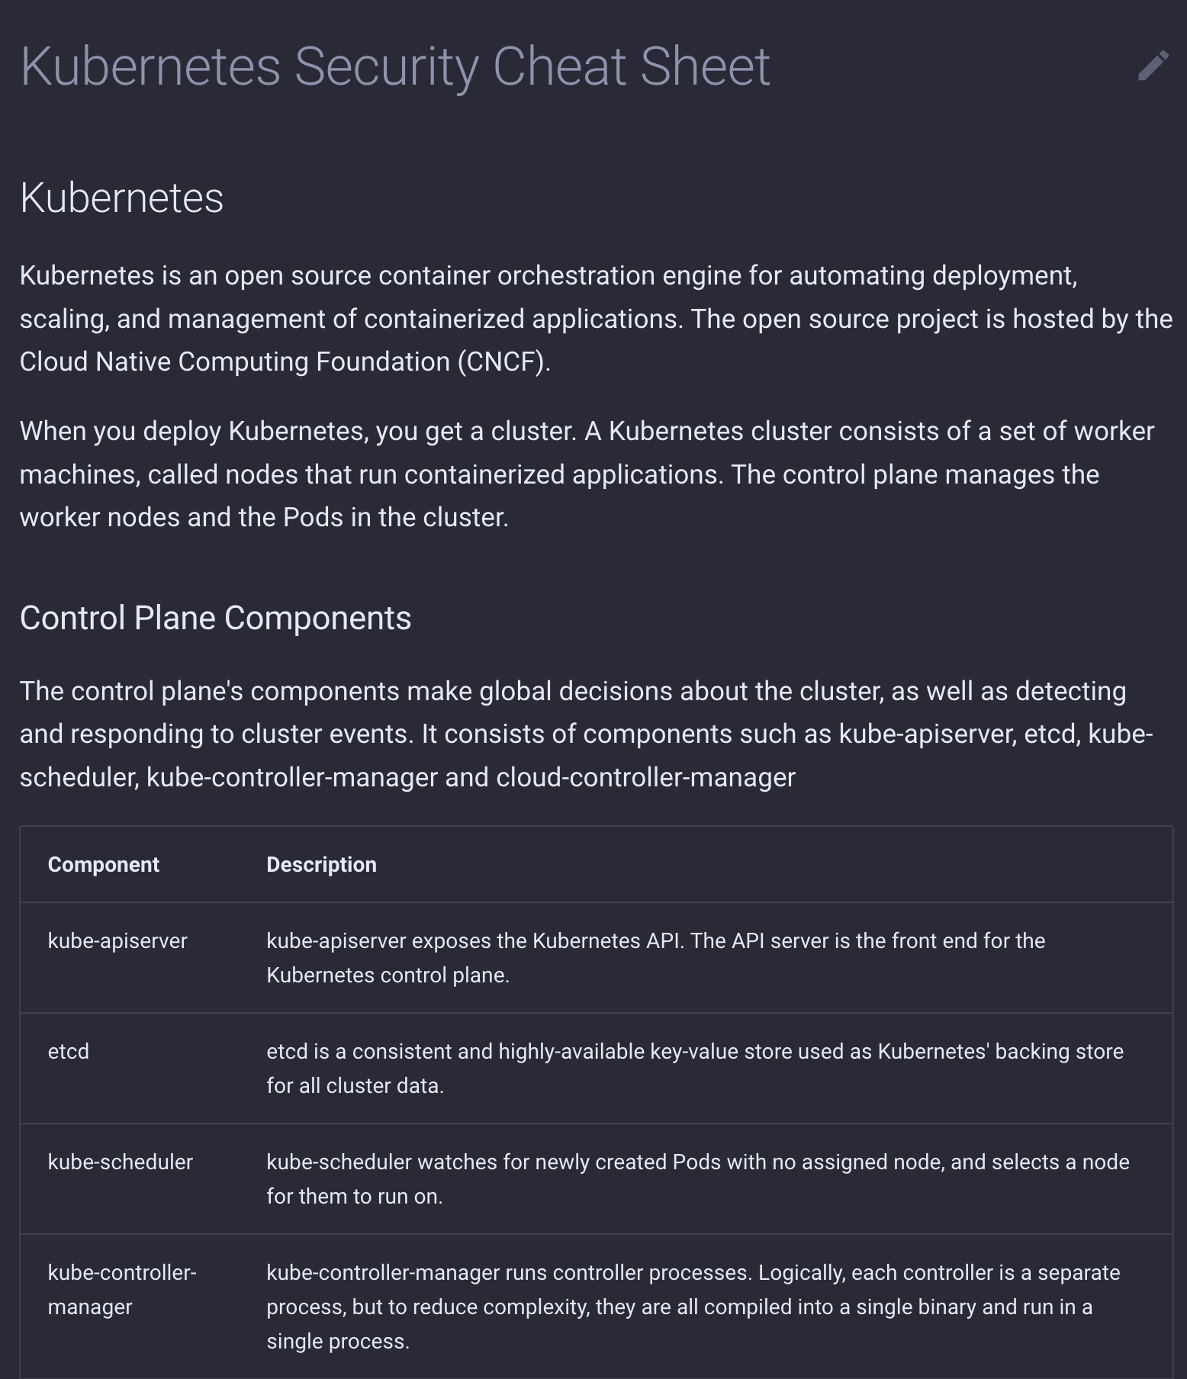
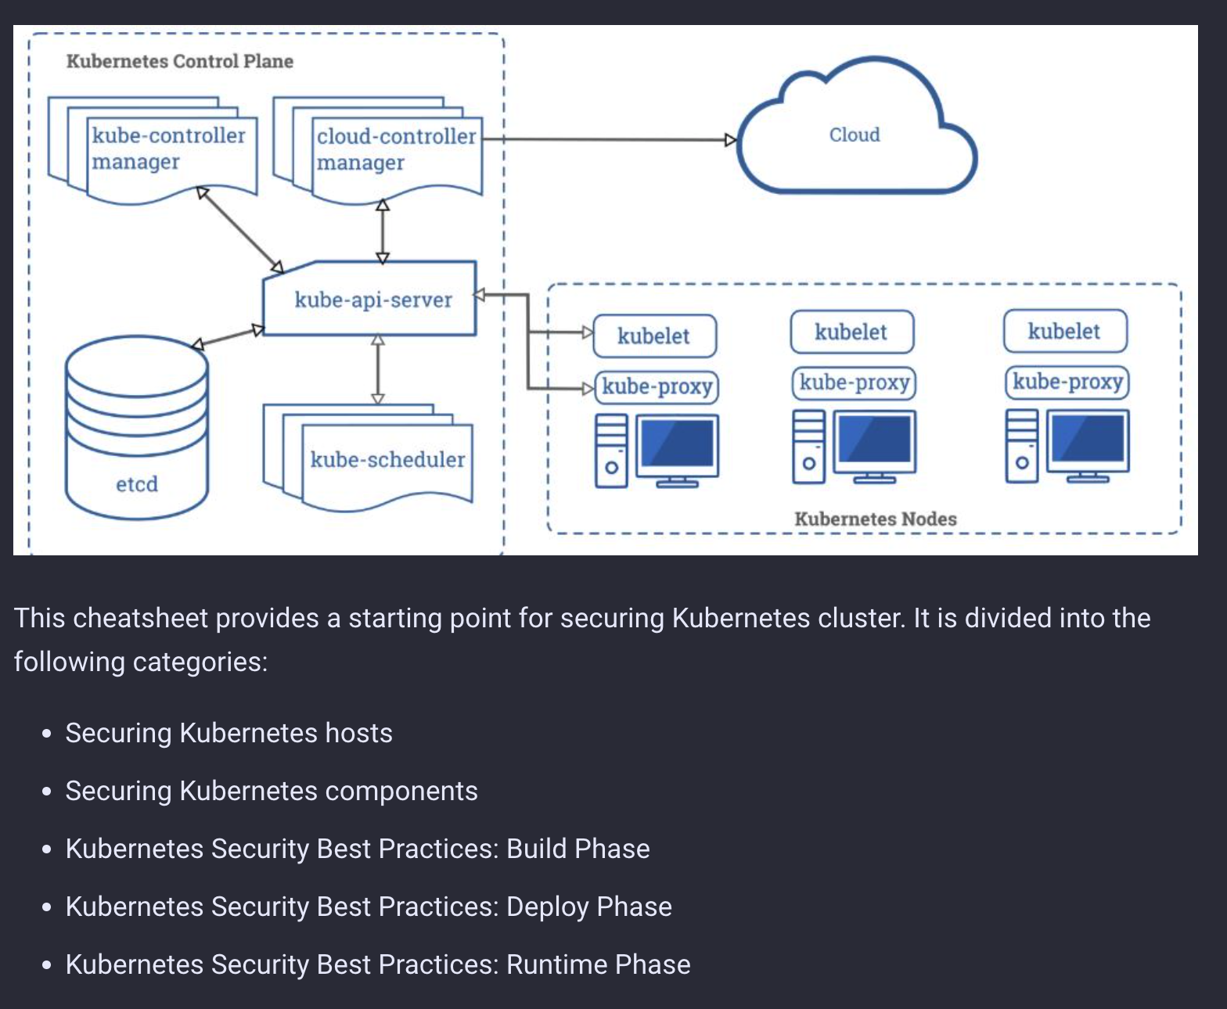
OWASP Cheat Sheet Series

Slide 59
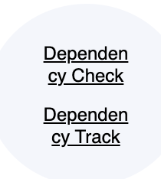
Implementation Related Projects - Dependencies
Dependency-Check (Software Composition Analysis tool)
Dependency-Track (Continuous SBOM Analysis Platform)
Notes:
https://www.youtube.com/watch?v=7knF14t0Svg

Slide 60
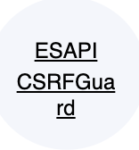
Implementation Related Projects - Secure Libraries
Enterprise Security API (ESAPI) (NodeJS and Java tooling)
CSRFGuard (Cross-Site Request Forgery prevention tool)
Notes:
https://www.youtube.com/watch?v=7knF14t0Svg

Slide 61
Verification

Slide 62
Verification focuses on the processes and activities related to how an organization checks and tests artifacts produced throughout software development.
This typically includes quality assurance work such as testing, but it can also include other review and evaluation activities.

Slide 63
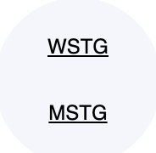
Verification Related Projects - Guides
Web Security Testing Guide
Mobile Application Security~ ~ = 2nd appearance
Notes:
https://www.youtube.com/watch?v=7knF14t0Svg

Slide 64
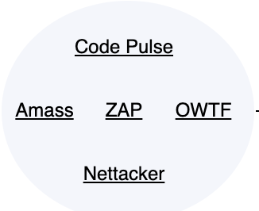


Verification Related Projects - Tools
Code Pulse (Code coverage)
Amass (Attack surface management)
Offensive Web Testing Framework
Nettacker - Pentesting and info gathering
ZAP*
Notes:
https://www.youtube.com/watch?v=7knF14t0Svg

Slide 65
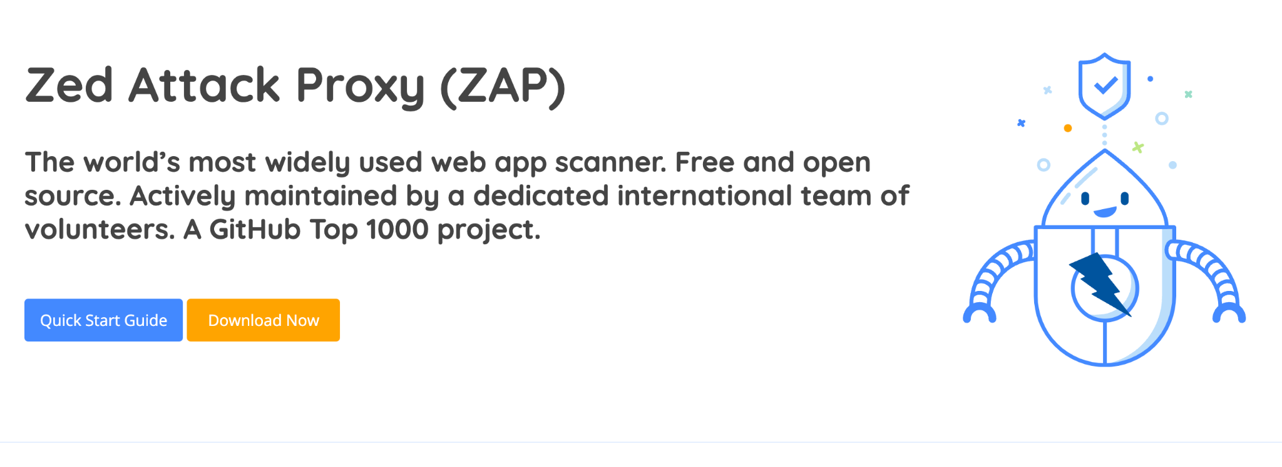
OWASP ZAP
Notes:
https://www.amazon.com/OWASP-Complete-Guide-Service-Publishing/dp/1867423413

Slide 66
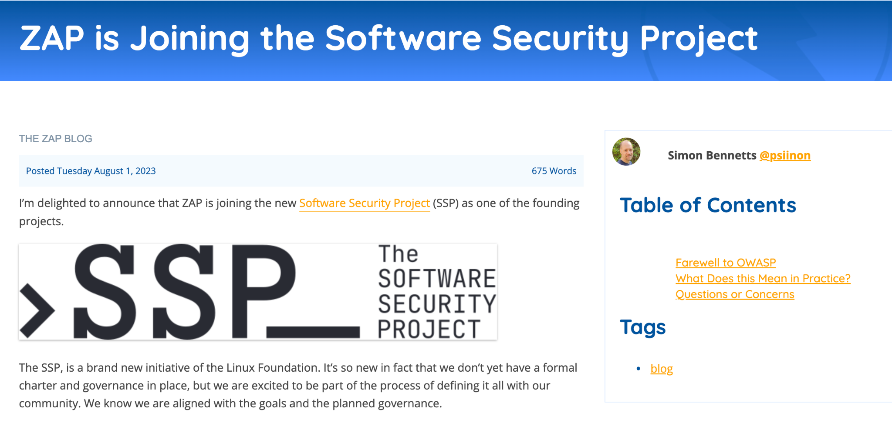
OWASP ZAP
https://www.zaproxy.org/blog/2023-08-01-zap-is-joining-the-software-security-project/
Notes:
https://www.amazon.com/OWASP-Complete-Guide-Service-Publishing/dp/1867423413

Slide 67
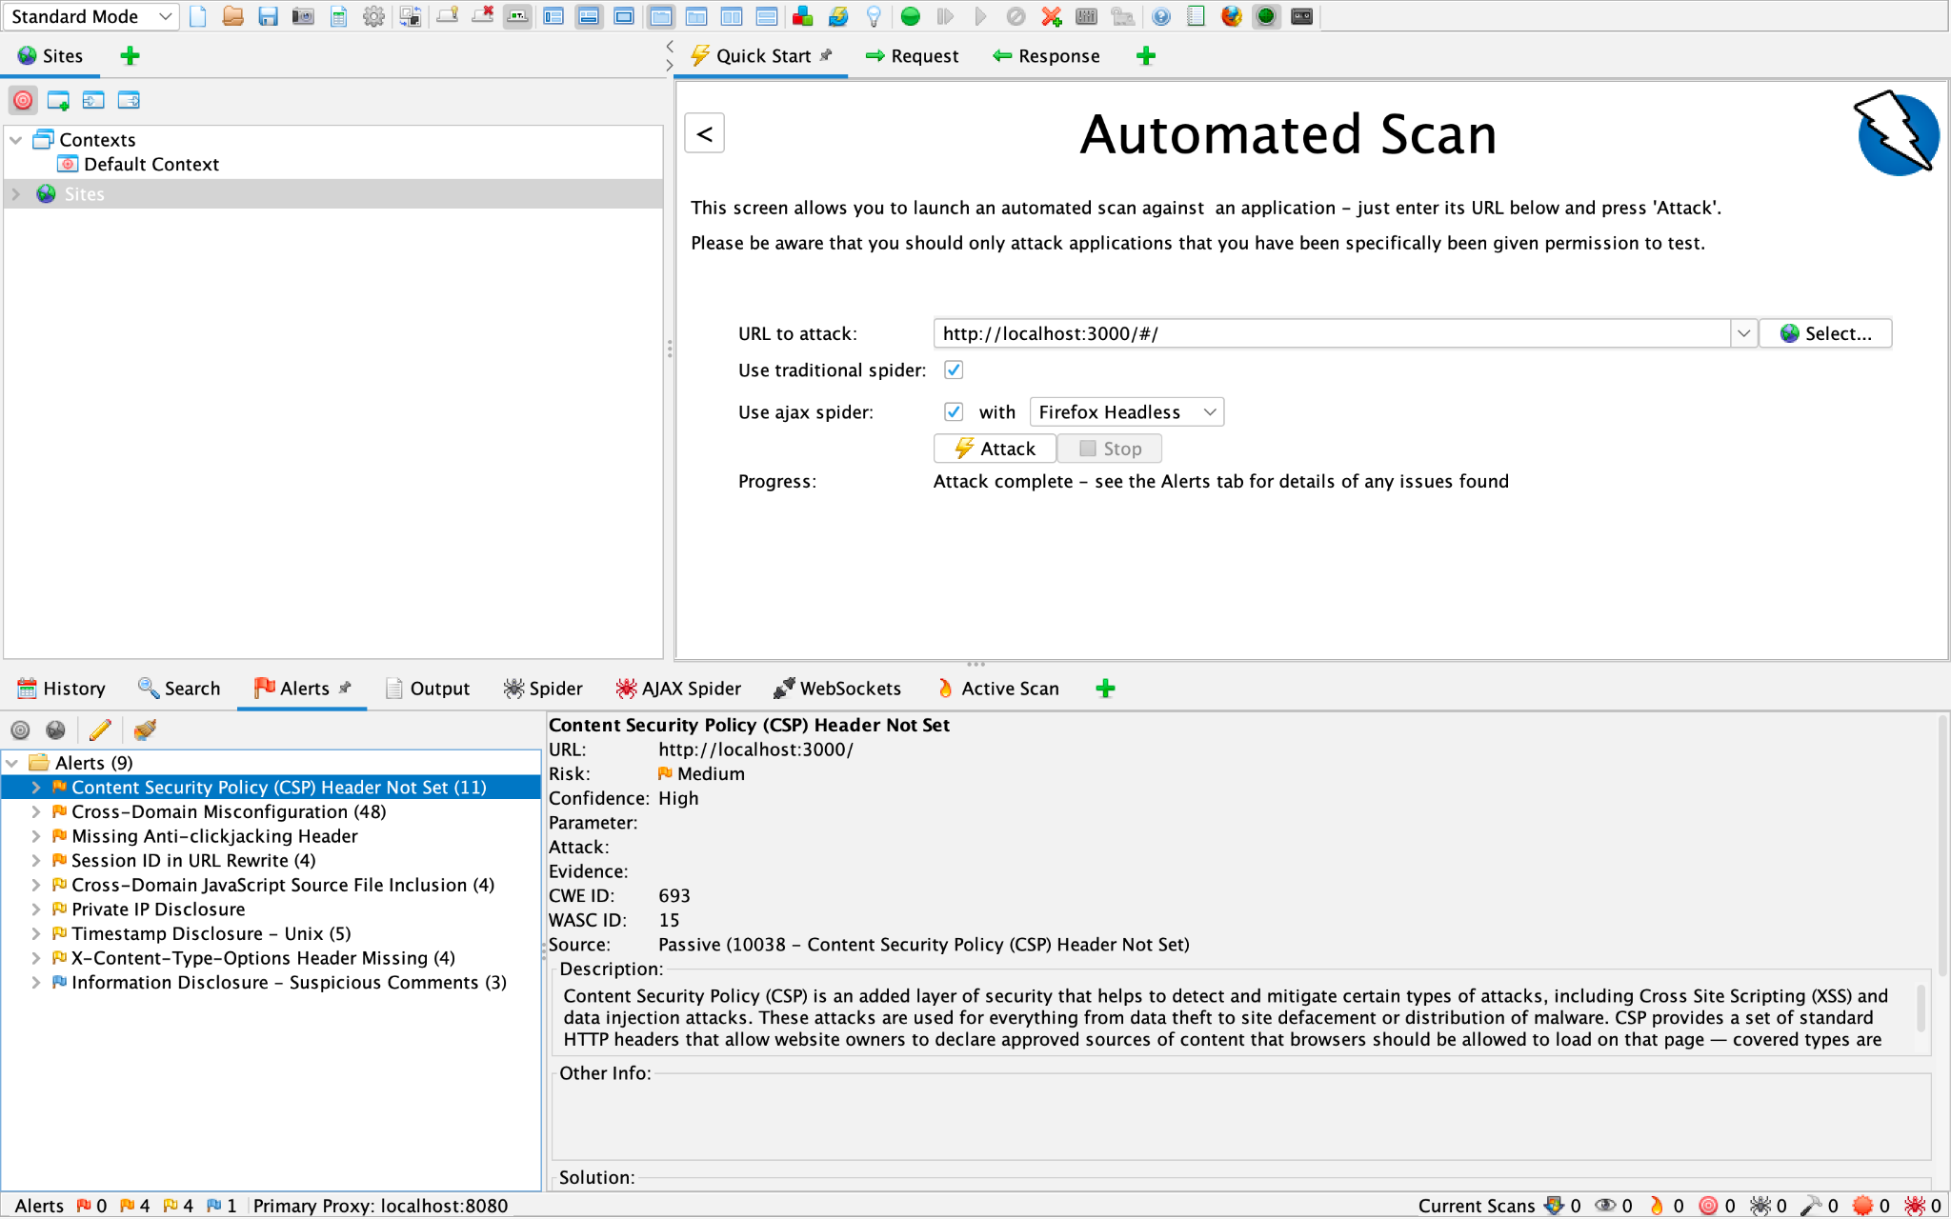
OWASP ZAP
Notes:
https://www.amazon.com/OWASP-Complete-Guide-Service-Publishing/dp/1867423413

Slide 68
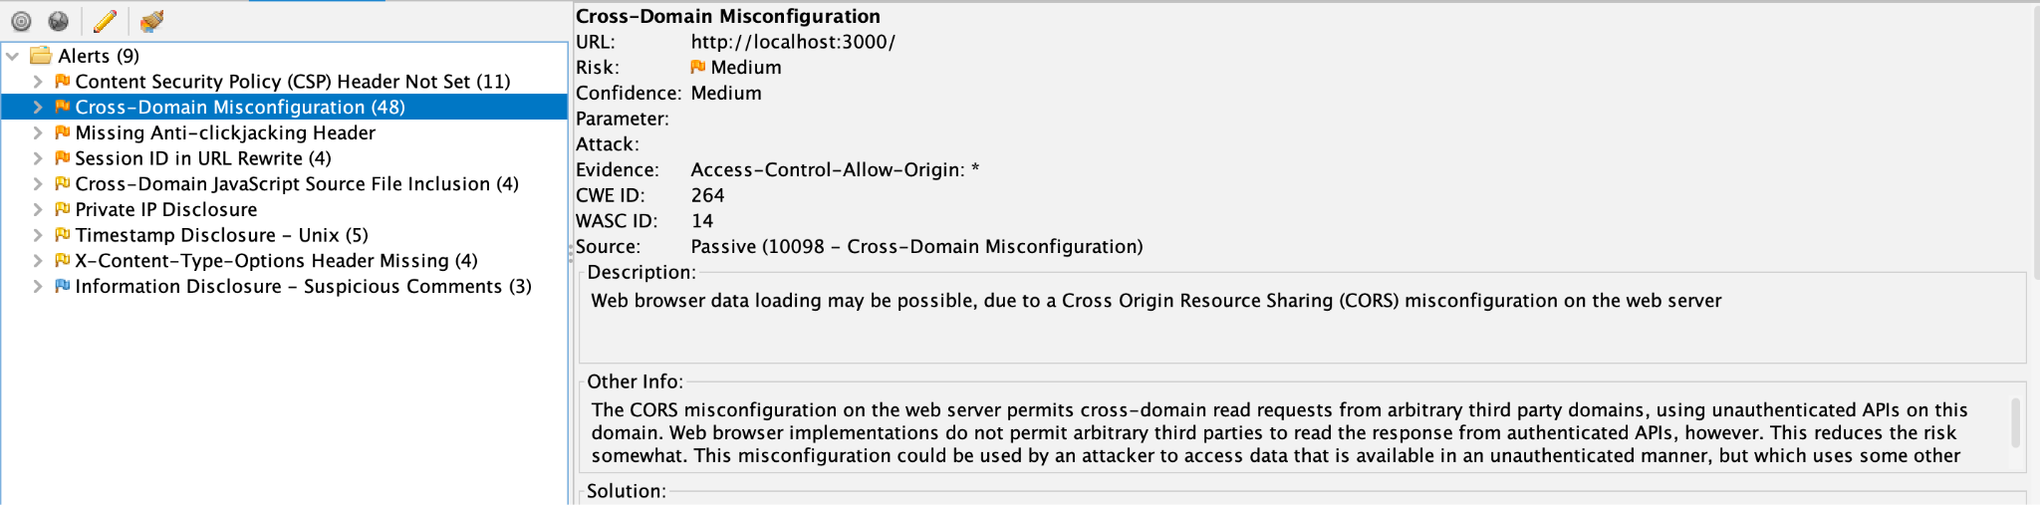
OWASP ZAP
Notes:
https://www.amazon.com/OWASP-Complete-Guide-Service-Publishing/dp/1867423413

Slide 69
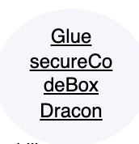
Verification Related Projects - Frameworks
Glue (framework for running security analysis pipeline tools)
secureCodeBox (Automated security testing Tool)
Dracon (Security pipelines testing for Kubernetes)
Notes:
https://www.youtube.com/watch?v=7knF14t0Svg

Slide 70
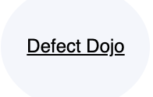
Verification Related Projects - Vuln Management
Defect Dojo (DevSecOps tooling - aggregator and single pane of glass for your security tools)
Notes:
https://www.youtube.com/watch?v=7knF14t0Svg

Slide 71
Policy Gap Evaluation

Slide 72
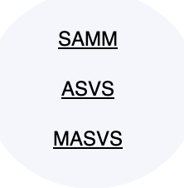
Policy Gap Evaluation Related Projects
Software Assurance Maturity Model*
Application Security Verification Standard^
Mobile Application Security Verification Standard^^
^ = 2nd appearance ^^ = 3rd appearance
Notes:
https://www.youtube.com/watch?v=7knF14t0Svg

Slide 73
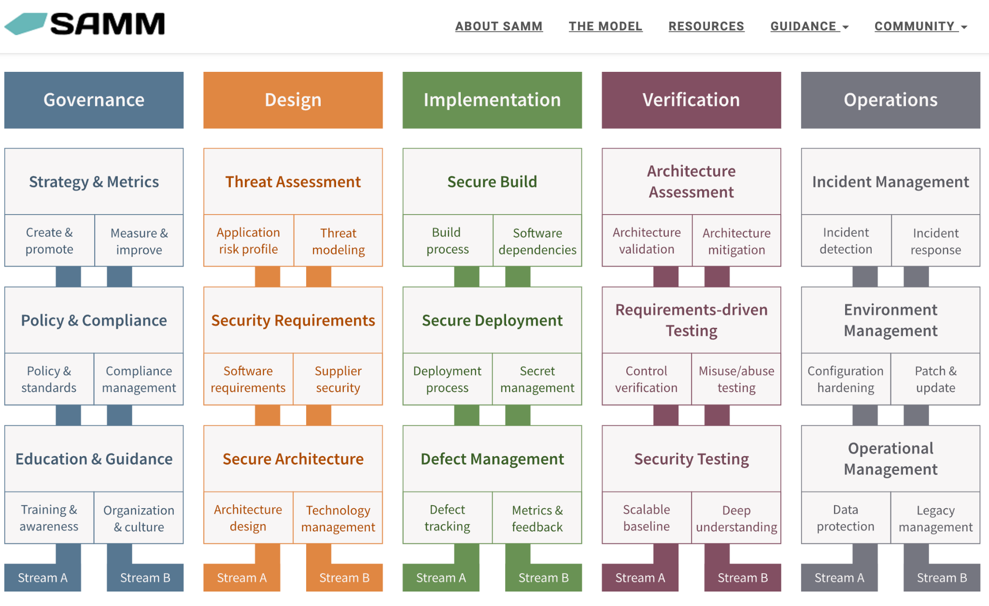

Slide 74
Metrics No projects directly map here?

Slide 75
Training/Education

Slide 76
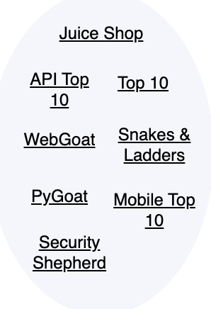
Training/Education Related Projects
OWASP Top 10s*
Juice Shop*
And the the other Goats
Security Shepherd - training platform
Snakes & Ladders - security board game
Notes:
https://www.youtube.com/watch?v=7knF14t0Svg

Slide 77
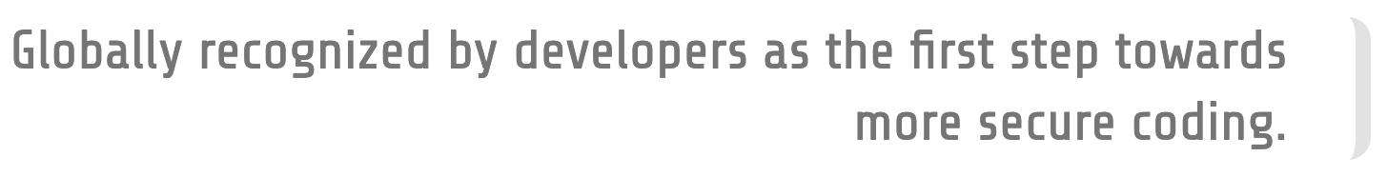
The OWASP Top 10
“The OWASP Top 10 is a standard awareness document for developers and web application security. It represents a broad consensus about the most critical security risks to web applications.”
Notes:
https://www.amazon.com/OWASP-Complete-Guide-Service-Publishing/dp/1867423413

Slide 78
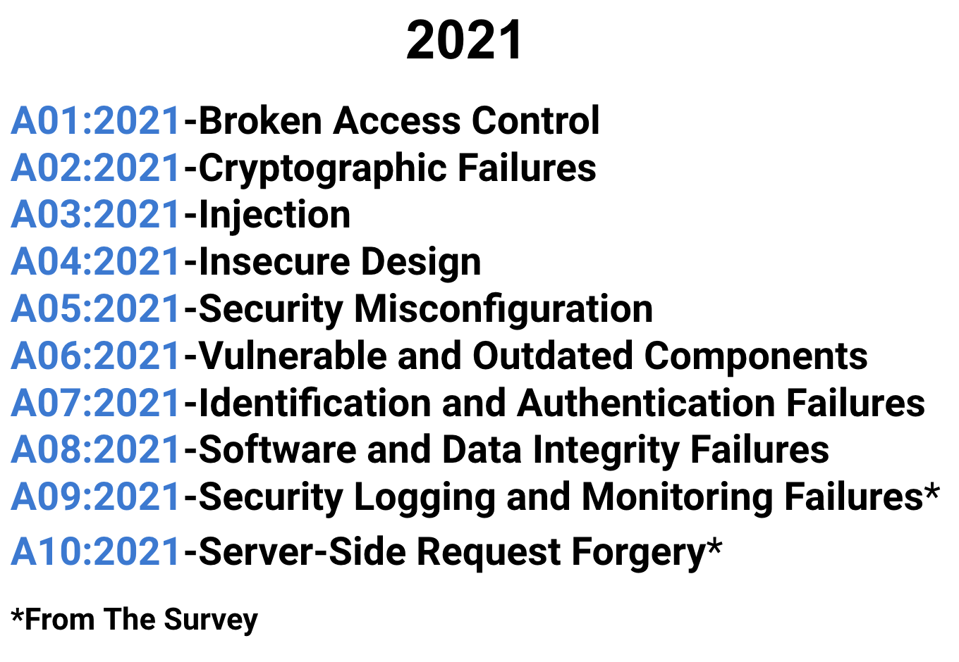
OWASP Top 10

Slide 79
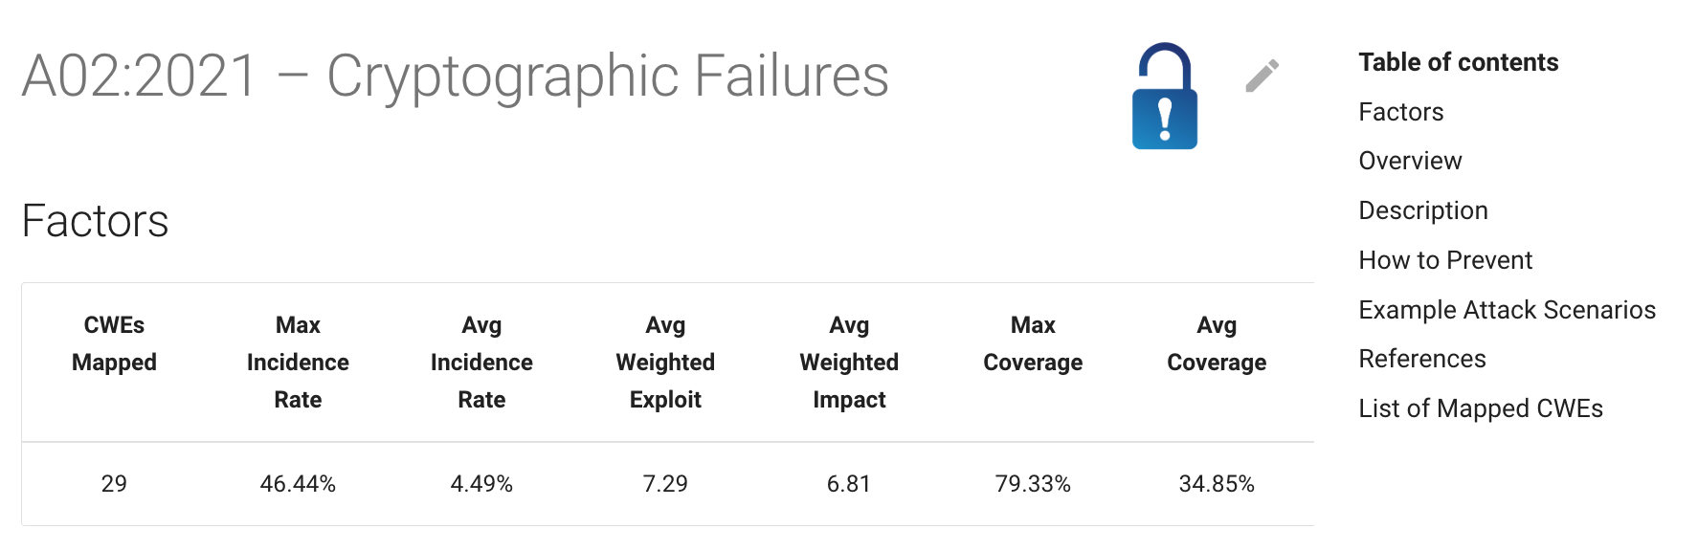
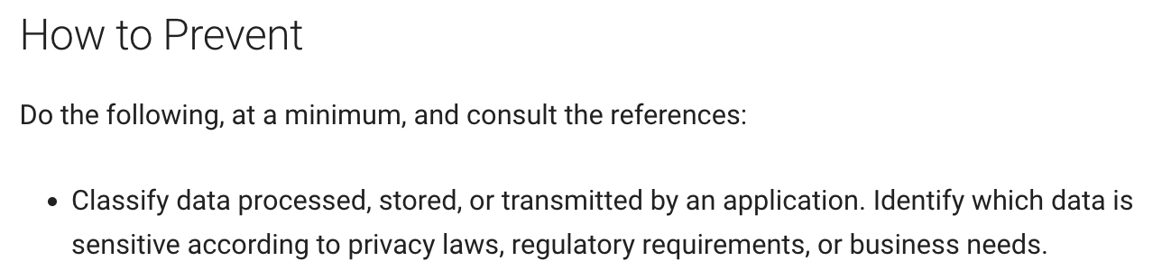
OWASP Top 10 Vulnerabilities
Notes:
https://www.amazon.com/OWASP-Complete-Guide-Service-Publishing/dp/1867423413

Slide 80
OWASP Top 10s
Mobile Security
API Security
CI/CD Security
Kubernetes
Low-Code/No-Code
Privacy Risks
7. Cloud-Native Application Security
8. Data Security
9. Desktop App
10. Docker
11. Serverless
12.Thick Client
13.Client-Side Security Risks

Slide 81
OWASP Goats
Goats are deliberately insecure applications for testing and training purposes
Lab Projects
WebGoat
Node.js Goat
WrongSecrets
Incubator Projects or Proposed
Pygoat
AndroGoat
ChainGoat
Laravel Goat
Webgoat PHP
SupplyChainGoat
Notes:
https://www.amazon.com/OWASP-Complete-Guide-Service-Publishing/dp/1867423413

Slide 82
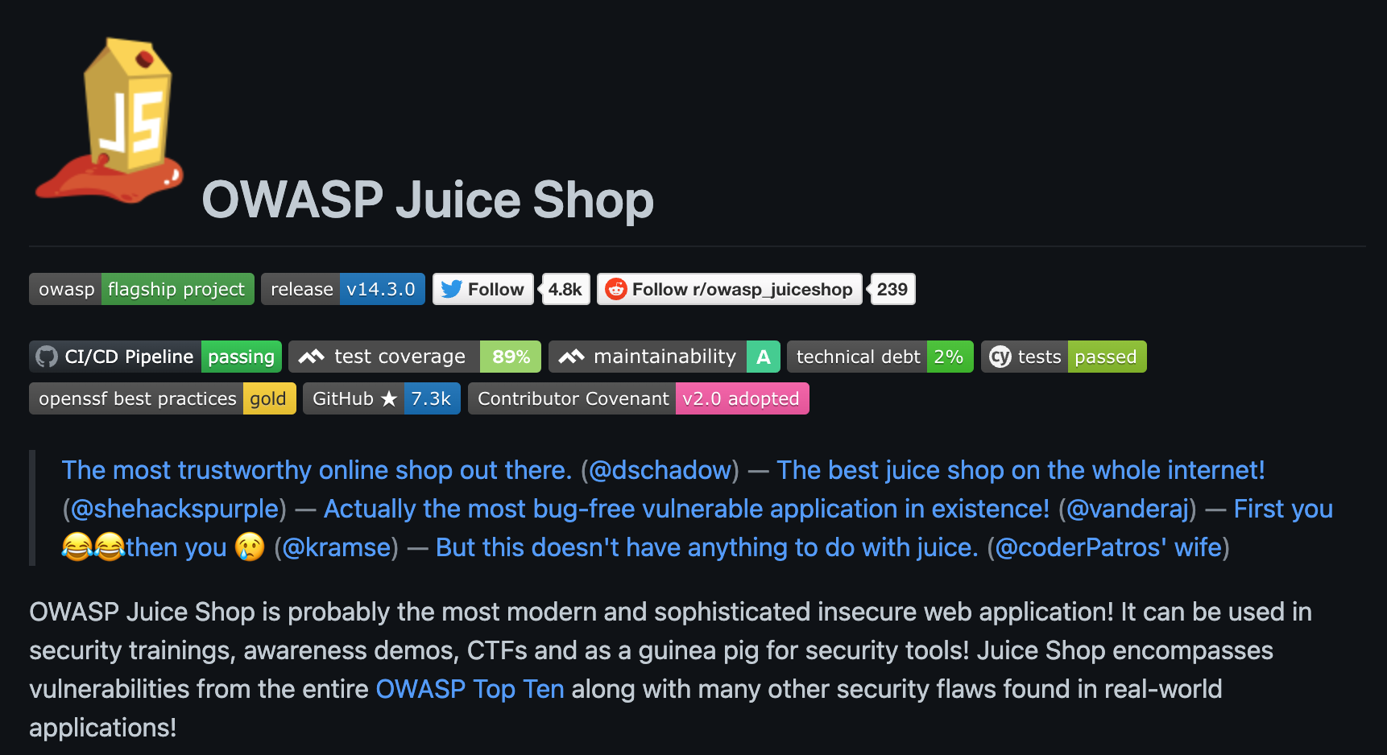
OWASP Goats
Notes:
https://www.amazon.com/OWASP-Complete-Guide-Service-Publishing/dp/1867423413

Slide 83

OWASP Goats
Extremely well
documented
an discussed
in media
Notes:
https://github.com/juice-shop/juice-shop/blob/master/REFERENCES.md

Slide 84

Demo by maintainer on YouTube
https://www.youtube.com/watch?v=n9DK87g_AIo
Notes:
https://github.com/juice-shop/juice-shop/blob/master/REFERENCES.md

Slide 85
Culture building and process maturing

Slide 86

Culture Building and Process Maturing Related Projects
Security Champions Playbook
Software Assurance Maturity Model^(2nd)
Application Security Verification Standard^^(3rd)
Mobile Application Security Verification Standard^^^(4th)
Notes:
https://www.youtube.com/watch?v=7knF14t0Svg

Slide 87
Operation

Slide 88
The Operations Business Function encompasses those activities necessary to ensure confidentiality, integrity, and availability are maintained throughout the operational lifetime of an application and its associated data.
Increased maturity with regard to this Business Function provides greater assurance that the organization is resilient in the face of operational disruptions, and responsive to changes in the operational landscape.

Slide 89

Operation Related Projects
ModSecurity Core Rule Set - (A set of generic attack detection rules for the ModSecurity WAF)
Notes:
https://www.youtube.com/watch?v=7knF14t0Svg

Slide 90
In Conclusion

Slide 91


Notes:
https://www.amazon.com/OWASP-Complete-Guide-Service-Publishing/dp/1867423413

Slide 92
Where are you involved?
Requirements
Design
Implementation
Verification
Policy Gap Evaluation
Metrics
Training/Education
Culture building and process maturing
Operation
Notes:
https://unsplash.com/photos/MtBsjmC4RT0

Slide 93
OWASP Getting Started
Top 10
Cheat Sheet Series
Goats (not the ‘greatest of all time’)
ZAP
Notes:
https://www.amazon.com/OWASP-Complete-Guide-Service-Publishing/dp/1867423413

Slide 94
Notes:
https://unsplash.com/photos/MtBsjmC4RT0

Slide 95
Hi, I’m Dwayne
I live in Chicago
I’ve been a Developer Advocate since 2016
On Twitter @mcdwayne
Happy to chat about anything, hit me up
Besides tech, I love improv, karaoke and going to rock and roll shows!
Dwayne McDaniel

Slide 96
Security Does Not Need To Be Fun: Ignoring OWASP To Have A Terrible Time

